Slide 1
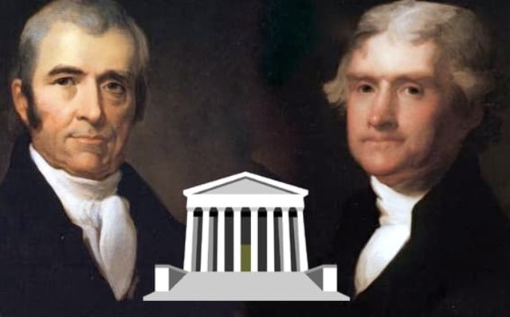
© Morgan AP Teaching
U.S. History
The Supreme Court
Notebook Page 5

Slide 2
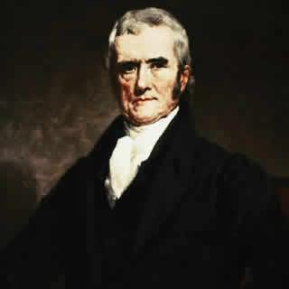
© Morgan AP Teaching
Marbury vs. Madison (1803)
In Marbury vs. Madison, the Supreme Court found an act
of the secretary of State James Madison unconstitutional
Jefferson had ordered Madison not to deliver appointment
papers to a previous-president’s (Adams) judicial selections
Marshall and his court made a landmark decision in this case:
…if Congress or the President did something that violated the
Constitution, the Supreme Court could void the action
This is known as judicial review, and it strength-
ened our system of checks and balances

Slide 3
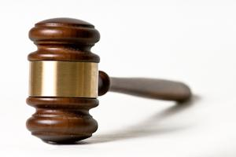
© Morgan AP Teaching
John Marshall
The Chief Justice at the time, John Marshall, was influential in
the case as a strong, assertive, and federally-minded Justice
He was the 4th Chief Justice of the United States (1801-1835), and is arguably the most famous and influential Chief Justice in US History
Before Marshall, the Supreme Court didn’t have much power
However, due to the rulings and efforts of Marshall’s court, he put
the SCOTUS on equally standing with the President and Congress

Slide 4
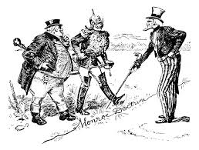
© Morgan AP Teaching
The Monroe Doctrine
As the U.S. government consolidated domestically, so did it too begin to consolidate itself internationally in 1823
With many other former colonies fighting for independence in the Western
Hemisphere, the U.S. took a stand of solidarity with fellow independence seekers
Known as the Monroe Doctrine, the U.S. took an official stance of formal
opposition to any Europeans meddling in newly-formed American states
While it agreed not to interfere in European control of current colonies
or their state affairs, it staunchly imposed European expansion in the Americas

