Slide 1
© Morgan AP Teaching
U.S. History
Manifest Destiny
Notebook Page 6

Slide 2
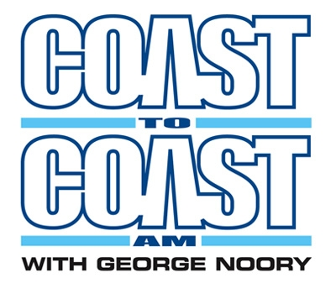
© Morgan AP Teaching
Manifest Destiny
Manifest Destiny was the belief that Americans were destined to spread the US from coast-to-coast
Specifically, to spread the special virtues of the
American people (democracy, industry, Christianity)
The U.S.'s mission was to redeem & remake
America in the image of the Western model
Additionally, most saw the Native Americans as barbaric
and uncivilized people in need of correction

Slide 3
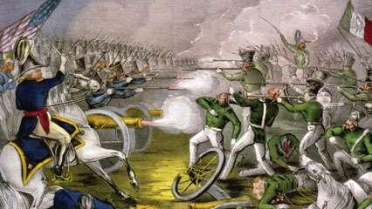
© Morgan AP Teaching
Acquisition of Land
First, we expanded via the Louisiana Purchase in 1803 as France desperately sought war funds
Then we convinced Spain to hand over the Florida territory
which was contained refugees, pirates, and hostile natives by 1819
Then we peacefully split the Oregon Territory with Britain in 1846
Finally, we defeated Mexico in a war and took the Southwest
as a concession following the Mexican-American War in 1848

Slide 4
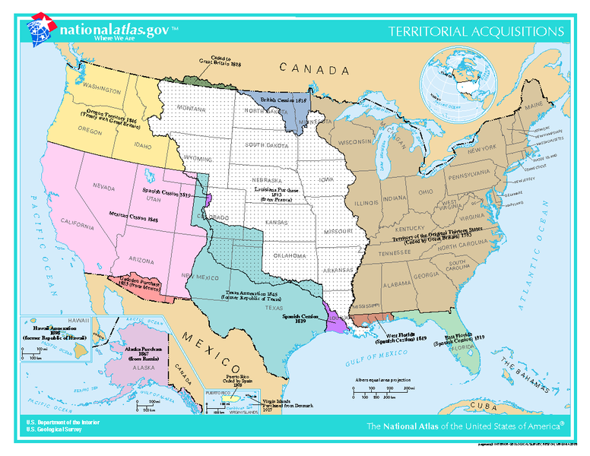

Slide 5
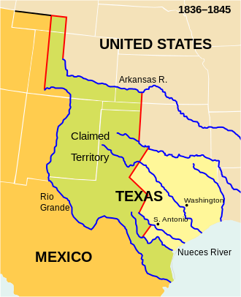

Slide 6
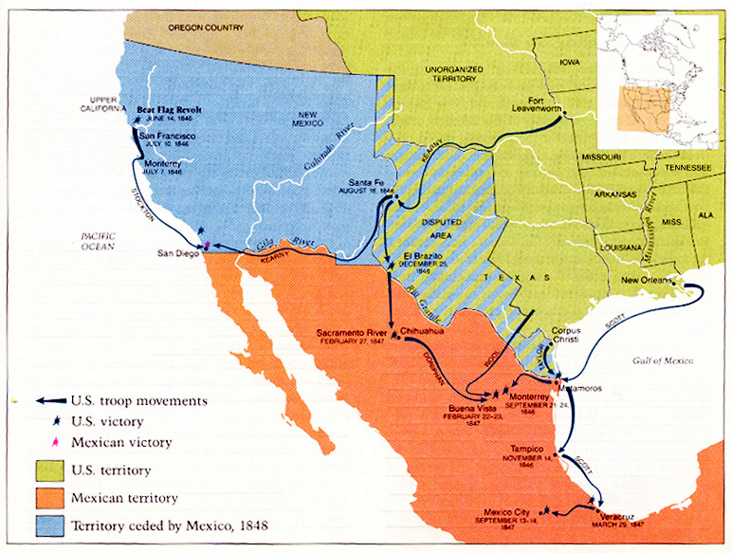
© Morgan AP Teaching
Mexican-American War (1846-48)
Wanting California, the US used a border disagreement to start a war with Mexico
After starting fighting by occupying a contested zone, the US invaded Mexico
Mexico was quickly forced to surrender due to American militaristic superiority
The Treaty of Guadalupe-Hidalgo signed over half of Mexican
Territory at low cost, and the rest was purchased shortly after

Slide 7
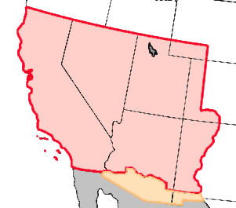
© Morgan AP Teaching
Mexican Session

Slide 8
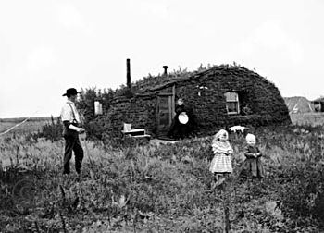
© Morgan AP Teaching
Settlement
Many pioneers ventured this new territory in hopes of becoming rich or seeking property
Starting in 1848, gold was discovered in California,
and cities and their populations grew rapidly
Lastly, thousands upon thousands rushed out west for
free land in the form of the Homestead Acts of 1862
The Homestead Acts gave away millions of acres
of land for free to anyone who could settle it

