Slide 1
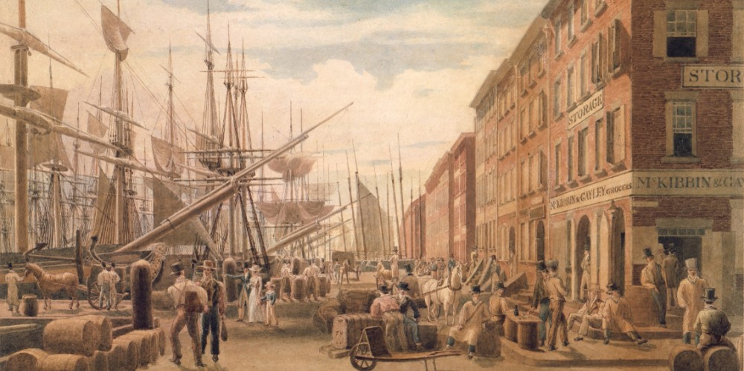
© Morgan AP Teaching
U.S. History
The English Colonies
Notebook Page 1

Slide 2
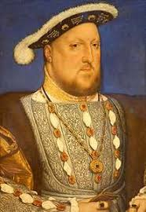
© Morgan AP Teaching
Anglican Persecution
Since the reign of Henry VIII and Elizabeth I in the 16th century there
had been very little in the way of religious toleration in England
Henry VIII and Elizabeth I had established and reestablished the Act of Supremacy
made the English monarchy official head of the Church of England
As the head, Elizabeth I enacted the Act of Uniformity
which greatly limited the religious freedom of Englishmen
This act required that Englishmen attend Anglican
Church on Sunday the Common Book of Prayer
Failure to uphold either of these would result in penalties
and persecution by Anglican officials and clergyman

Slide 3
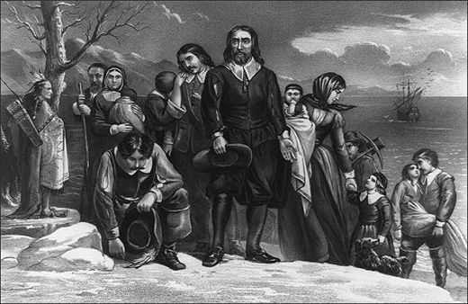
© Morgan AP Teaching
Pilgrims
One of the primary groups to oppose such measures (besides Catholics) were the Puritans
Puritans were Protestants who held true to the message of Luther (and especially
Calvin) that rejected Catholic tradition, rituals, hierarchy, and papal authority
As the split of the England church from the Catholic Church in the early 16th century
was predicated more on political power and the desire for Henry VIII's marriage annulment,
the Anglican Church remained remarkably similar to the Roman Catholic Church
As such, the 'Puritans’ were Protestants that desired a more purely Protestant church
Consequently, those Puritans who opposed the Act of Uniformity
in income and traditions were pure persecuted to the point of exodus
Many Pilgrims (Puritans who left England) left for the religiously tolerant Netherlands and
the English colonies which remained largely free of Anglican officials and monarchal authority

Slide 4
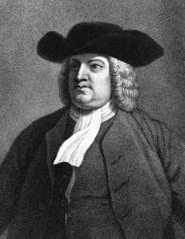
© Morgan AP Teaching
Religious Freedom
Seeking religious asylum, many of the early colonists were either
economic opportunists or religious dissidents seeking refuge and autonomy
One such colony was the Massachusetts Bay Colony founded in 1628
Led by John Winthrop, the Massachusetts Bay Company established a Puritan colony meant to function
as a religious model for the rest the world; Boston was dubbed ‘a city upon a hill’ by Winthrop
Likewise, several decades later, William Penn established
the colony of Pennsylvania as a Quaker colony in 1681
Quakers were a radical Puritan group pacifism; this meant that not only did they
not fight back against persecution, but they allegedly only 'quaked' in fear of God
rather than any man or element of nature (and this is how they got their name)
Regardless of the colony, this religiously-tolerant trend was indicative of most
colonial settlements in the English colonies during the 17th and 18th centuries

