Slide 1
U.S. History
The Market Revolution
Notebook Page 8
© Morgan AP Teaching

Slide 2
© Morgan AP Teaching
Free Enterprise
By the 1800s, economic strategies had begun to change
A newly-developed theory and practice put production in the hands of
the market (supply and demand) rather than guilds or governments
It promoted entrepreneurship—the starting of new industries
and businesses—to meet the needs of society (the invisible hand)
It also argued that prices and quality would be high,
due to the competition for business between companies

Slide 3
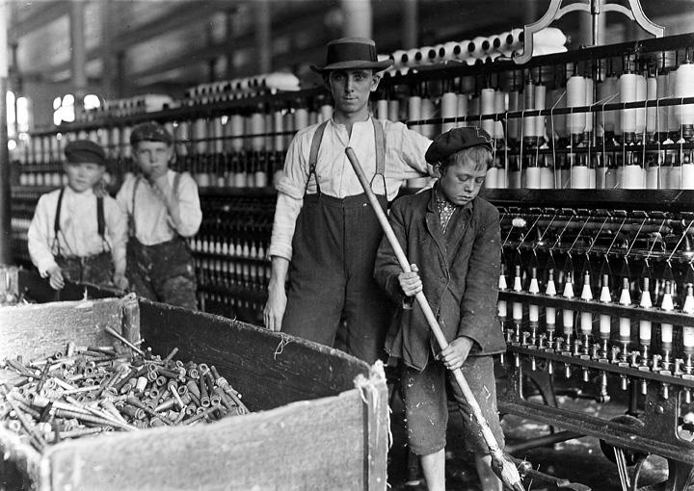
© Morgan AP Teaching
Market Revolution
American business quickly adopted free enterprise
Many private businesses began to compete and grow,
and greatly expanded communication and transportation
People now focused on buying and selling cheap goods rather than making it themselves
Workers made goods and companies grew rich and powerful providing for the market
Despite these benefits, there were many cons including dangerous
working conditions, low wages, long hours, and child labor

Slide 4
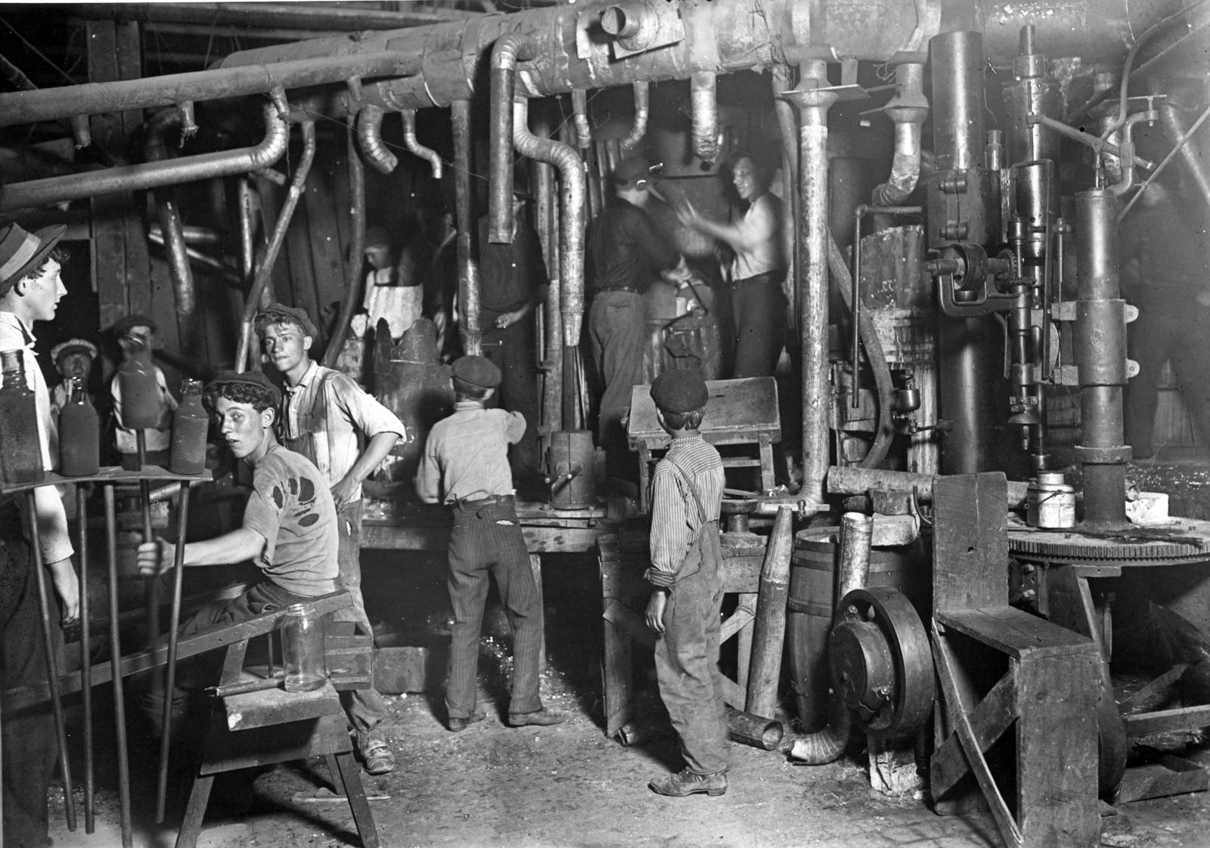

Slide 5
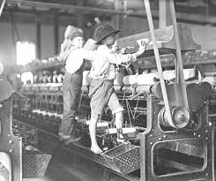

Slide 6
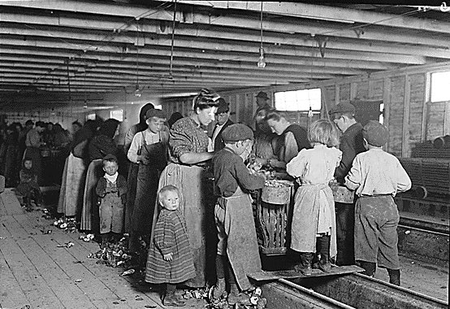

Slide 7
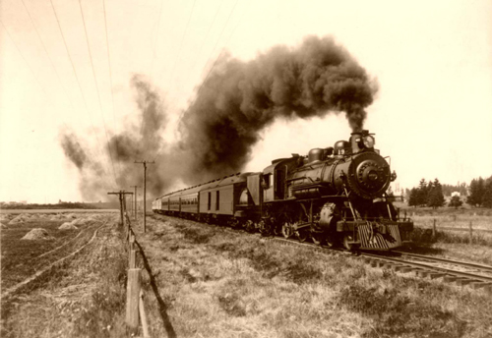
© Morgan AP Teaching
Technological Improvements
Morse code/telegrams made communication much quicker, until the telephone’s invention later
Canals connected networks of northern states and supply routes via steam boats
Railroads improved transportation and connected the nation
Roads also drastically improved transportation
These factors combined to make transportation much cheaper,
quicker, and more effective, thus reducing prices and promoting sales

Slide 8
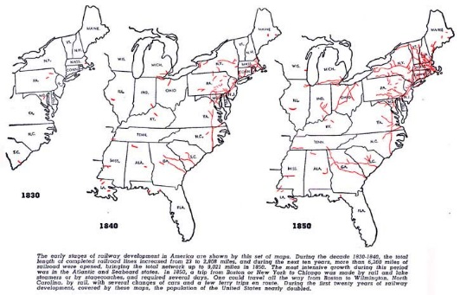
U.S. Railroad Expansion (1840-1850)

Slide 9
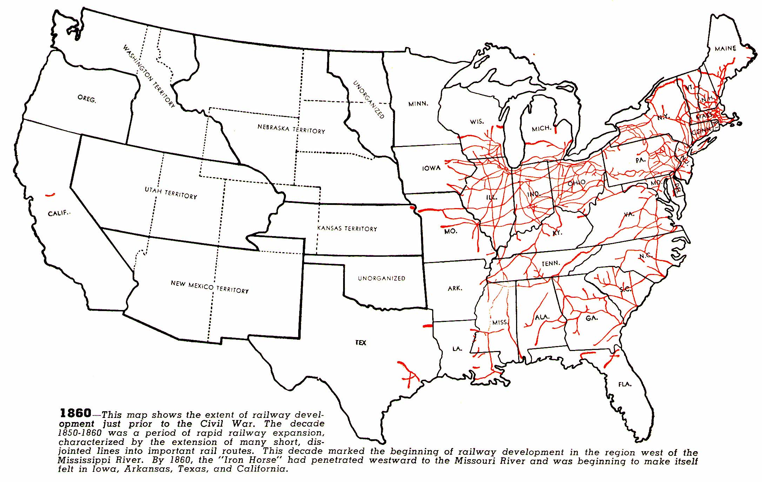

Slide 10
© Morgan AP Teaching
Cash Crops
While the North flourished, creating transportation, communication
networks, and goods and wealth from factories, the South stagnated
Cotton grew well in the South and it began to take over southern farms
The South sold this cotton to the North for textiles, as well as Britain &
France, but it did not promote economic growth as well as free enterprise
Southern plantations remained focused on agriculture, became rich,
but paled in comparison to the wealth and development of the North
The South also remained heavily dependent on the labor of African slaves, and wanted its preservation

Slide 11
