Slide 1
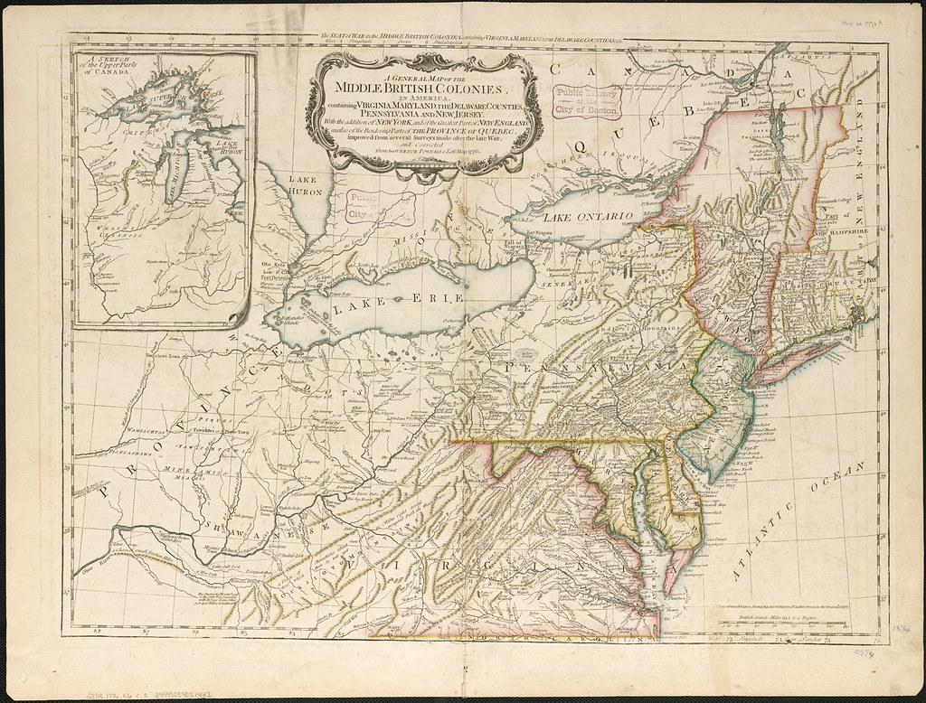
© Morgan AP Teaching
U.S. History
Colonial Governments
Notebook Page 2

Slide 2
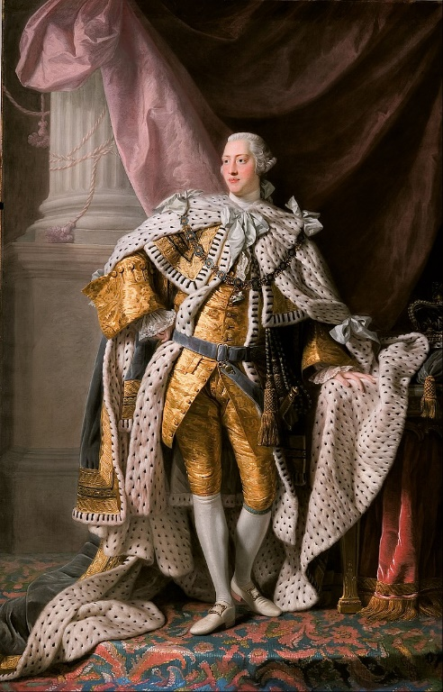
© Morgan AP Teaching
Benign Neglect
One of the primary factors determining American culture and political views
was the unintended policy of ‘benign neglect’ practiced by the British crown
With an entire ocean wean them, as well as multiple civil and foreign conflicts in Europe, the British crown did not have the time, money, or resources directly manage and administer the colonies
As such, colonies operated much like autonomous individual states;
colonial governments collected taxes, raised militaries, and dictated commerce
While these may all be normal governmental practices, such
autonomy technically required the approval the British monarchy
However, without the resources to administer or enforce policies, the colonies were essentially
went decades without any real supervision or management by the British government

Slide 3
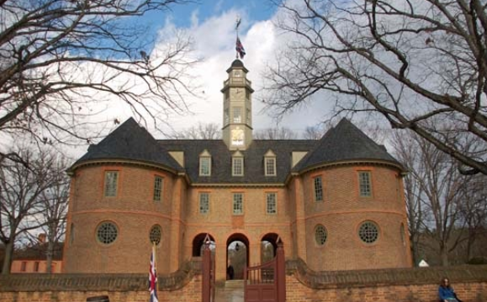
© Morgan AP Teaching
Unique Governments
There were many different forms of government in the colonies but one thing
most had in common was that, despite their differences, they were successful
One such example the colony of Virginia which was
established in 1642 colonial representative assembly
This representative assembly was known as the House of Burgesses; it was an
elected assembly that had the authority to levy taxes and establish a militia
They, like most other colonies, also upheld English Common Law and established regional judges -- all this in spite of the fact that their administration was a complete departure traditional British nobility and monarchy
Others like Carolina and Georgia also setup unique forms of government, run by non-nobility, and maintained the fundamentals of English law and society

Slide 4
© Morgan AP Teaching
Impact of Benign Neglect
As colonies developed governments and practiced near autonomy, they
became increasingly independent, albeit still loyal to the British crown
Levying their own taxes, establishing militia and successful agriculturally-based economies, stabilizing, and expanding were all a testament to American ingenuity and sustainability
This, combined with their zeal for religious toleration, quickly resulted in
colonists developing their own identity-- particularly after defending themselves
from other Europeans and Native Americans (such as King Philip’s War)
As such, years later when the British would attempt to establish more control over
the colonies, the colonies would almost universally call for independence or, at the
very least, a continuation of their near autonomy and a voice in the British government

