Slide 1
The Lord of the Flies Trial
ELA 8th Grade 2021
After reading and studying the book intensely, students role-played a trial from the British Court System
The jury deliberated each class to determine the accused guilt
Judges made sentences based on the verdicts rendered

Slide 2
The Scene of the crimes of murder

Slide 3
On trial for the Murder of Piggy and Simon

Slide 4
The Judges

Slide 5
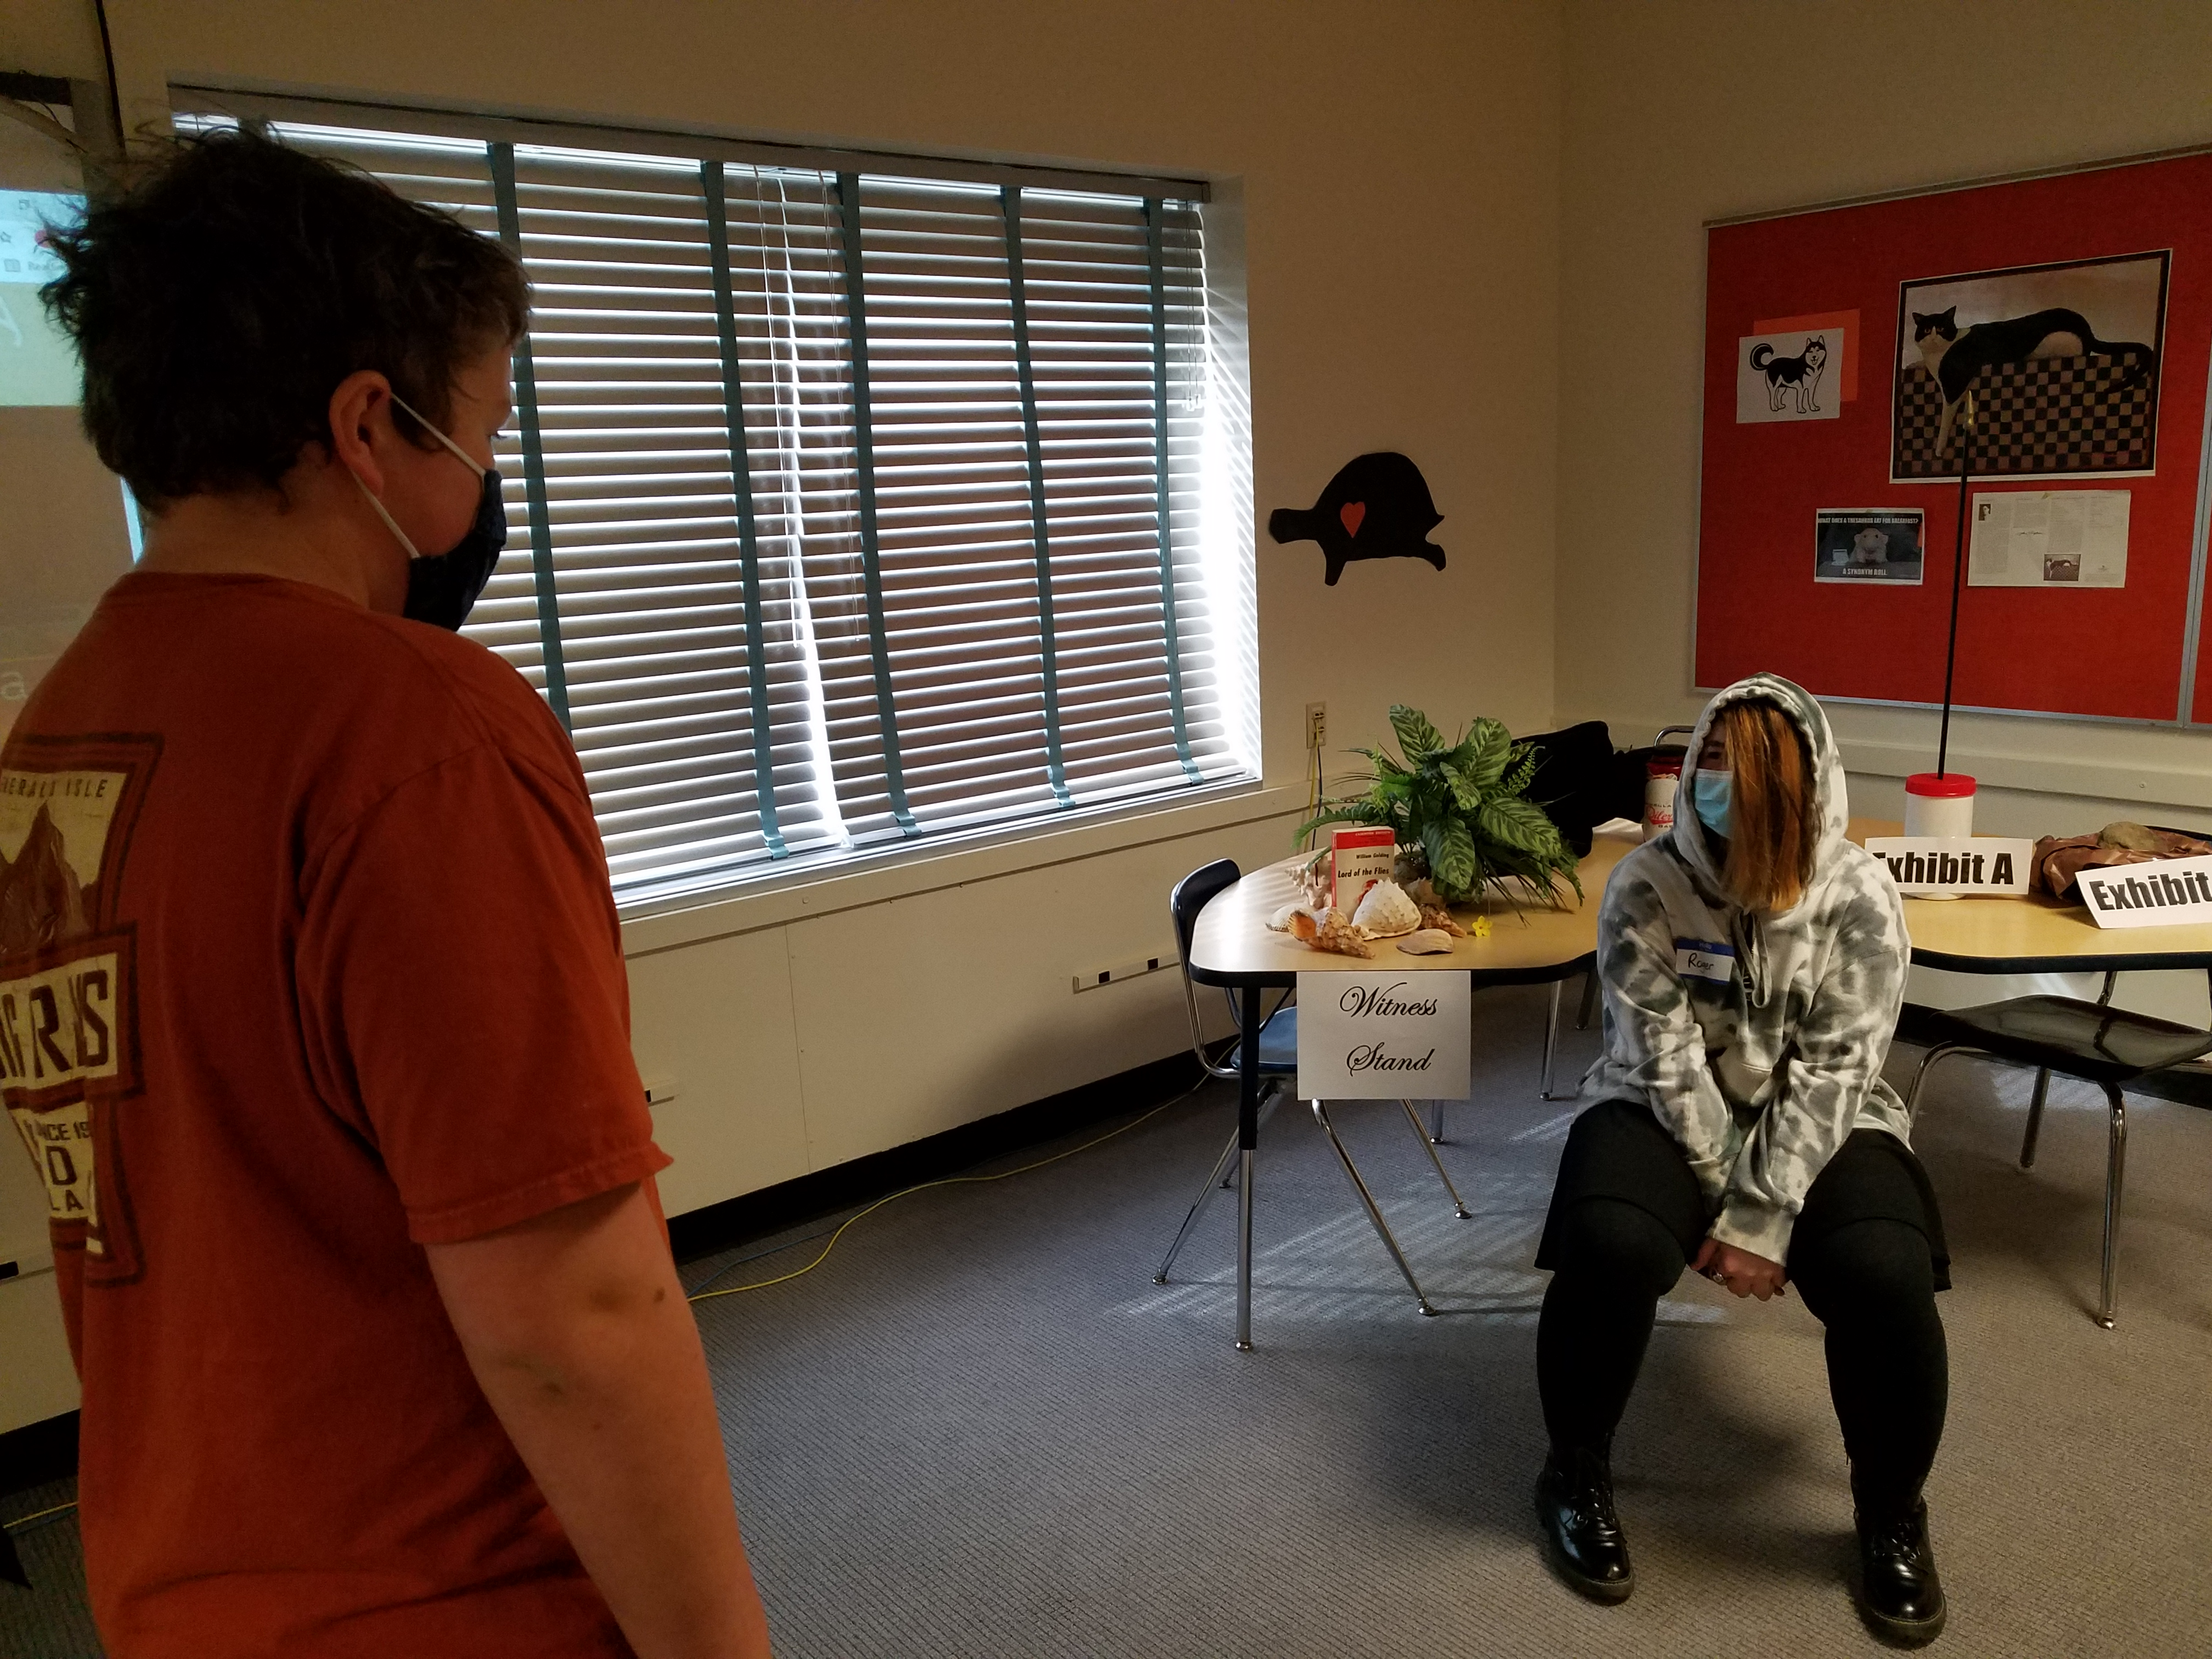
The Witnesses for the defense

Slide 6
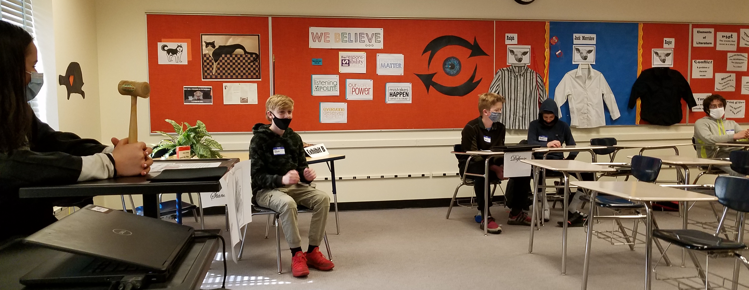
The Witnesses for the defense

Slide 7
The Witness for the Prosecution

Slide 8
The Jury has a verdict

