Slide 1
As you arrive . . .
Review the posted Shared Agenda
What would you like to know or ask about MAP® Growth™ assessments?
Write these comments/questions on sticky notes (one per note) and place on the Shared Agenda
From the Canvas Course, please download these documents to use during the workshop today
5-19 Map Growth Basic Handout - Proctor Tips and Trouble Shooting
Administrator Guide - 5-19 MAP Basic Planning
Proctor Guide
Notes:
Hidden slide

Slide 2
Trish Tracy
Trish Tracy
Consultant for NWEA for 13 years
Past WA State OSSI School Improvement Coach
Retired Moses Lake School District
Director of Special Education
Director of Federal and State Program/Assessment Coordinator
Elementary Principal
Elementary Teacher
Trish.tracy@nwea.org
509-989-5307
Notes:
Facilitator to add a picture, title, and contact info.

Slide 3
MAP Administration

Slide 4
Learning Targets
Identify the purpose of the MAP Growth assessments
Create a partnership in using data to improve student learning
Success Criteria
Describe how MAP Growth data supports or differs from other data sources
Develop strategies to prepare students to successfully take MAP Growth assessments
Develop an action plan using MAP Growth Resources for your site to train teachers/proctors and implement MAP Growth assessments in fall

Slide 5
Intended Accomplishments
Employ a systems approach to planning and implementation
Understand the MAP Growth assessment
Understand MAP Growth data characteristics
Identify uses for MAP Growth data

Slide 6
Getting Started
Welcome
Introductions
Review the shared agenda
Materials review and Padlet® link
Take a look at your materials
padlet.com/NWEApl/MG_Basics
Notes:
Click on the link or image to open Padlet.

Slide 7
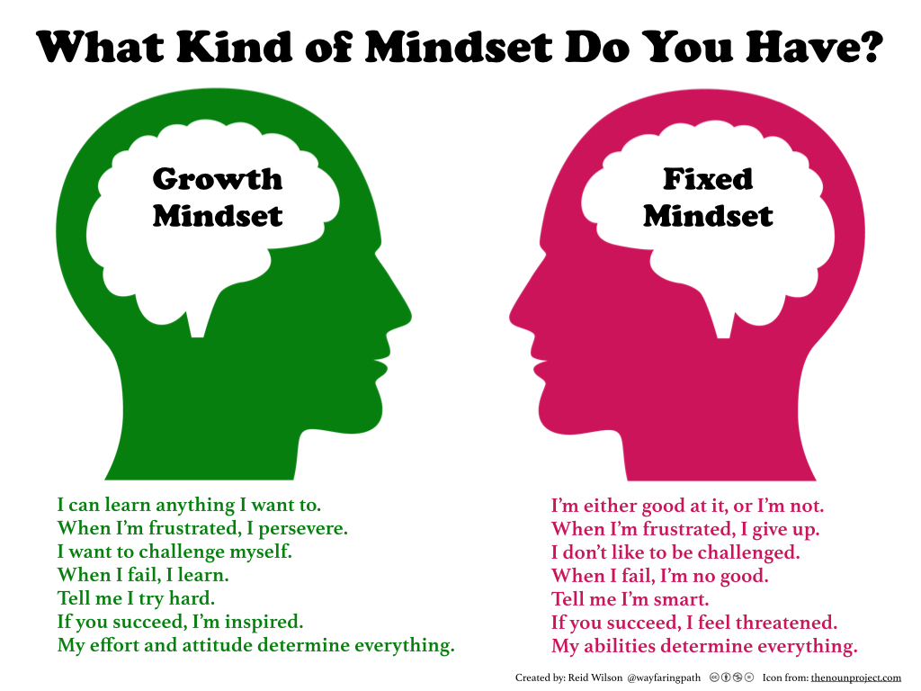
What is your mindset today?
How might your professional learning experience be impacted by your mindset?
By your colleagues’ mindset?
Please turn/talk with your neighbors…
Notes:
Share image and ask participants to read, or read to them if image too small for those in the back of room
Click first 3 bullets one at a time, pausing to let the question sink for a moment for personal reflection
Click for last bullet to invite participants to turn/talk to process their mindset
Share whole group to generate discussion about our mindset as adult learners
(Some may even make the connection about what we “allow” in our mindsets as adult learners that we would not wish to see or cultivate in our students)

Slide 8
Working Together
Formatively check in and make decisions
Put ideas on the table
Pay attention to self and others
Everyone participates
Pause, paraphrase, and probe
Presume positive intentions
Balance
advocacy and inquiry
Start and end on time

Slide 9
01
Experience MAP Growth

Slide 10
What characteristics are important in assessments?
Take two minutes to write down the important characteristics of assessments that you use
Share out with your team

Slide 11
What assessments do you use in your school?
What assessments were used at your site this past year?
What was the purpose of each?

Slide 12
Three categories of Assessments
Summative
Which of the categories do the assessments you used fit into?
Why is it important to use different types of assessments?
Formative
Interim

Slide 13
MAP Growth Assessments
Chacteristics
Subjects
Assessments are between 40 and 64 questions
End of testing student screen shows overall score, goal area scores, and testing time
Three levels - K-2, 2-5, 6+
Reading
Math
Math End of Course
Algebra I
Algebra II
Geometry
Language Arts
Science (Additional cost)

Slide 14
Features of MAP Growth
Challenging, appropriate, and dynamic
Provides immediate results for students
Untimed
Accommodations and Designated Supports available
Accurate data
Frequency of assessment:
MAP Growth: up to four times a year – F, W, S, Summer

Slide 15
MAP Growth Characteristics
Measures growth and identifies instructional level
Informs instructional decisions
Gives immediate data and dynamic, interactive reports available within 24 hours

Slide 16
MAP In KPBSD
3x a year defined by district
Helps to triangulate data
Supporting all students for instruction
Personalized Learning
Classroom Differentiation
Support intentional action plans for
RTI, gifted and talented, migrant priority for service, EL students and special populations

Slide 17
Hands-on Practice and Preparing Students
Experience the MAP Growth assessments
As you work, consider your students and think about how they might experience this assessment
Preparing students to test- read Student Introduction one sheet
Student Introductory Video
Test tools
Practice tests
Building a Growth Mindset for testing
| pp. 4, 24-25 C.C.-Student introduction

Slide 18
Jump Right In-Practice Test
https:test.mapnwea.org
Student Resources
Student video
Test tools
Practice test - user name – grow password – grow
Stop and Jot questions and comments as you go…
Consider how you will prepare students for testing
What questions might they have?
WB 4

Slide 19
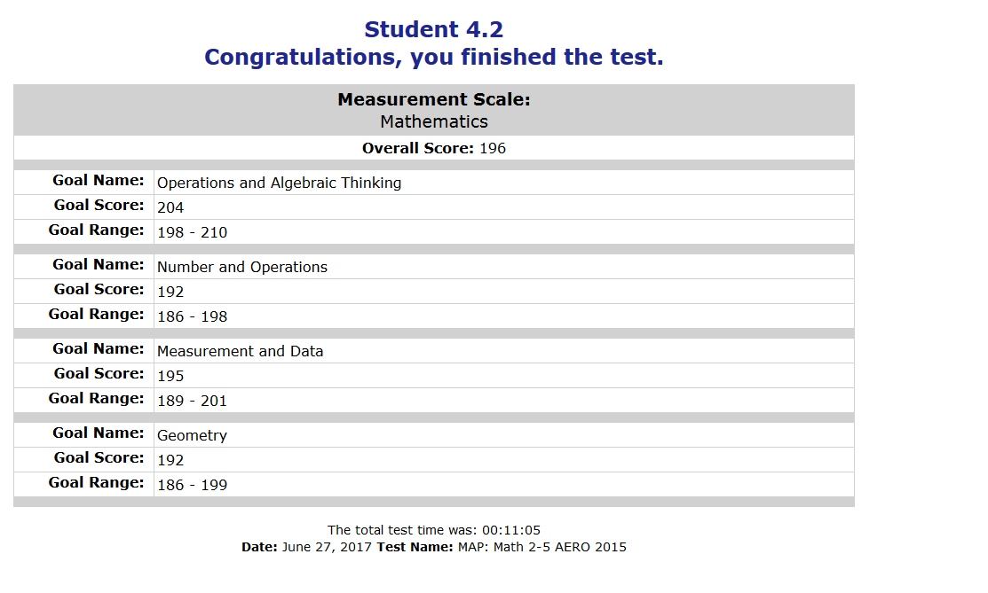
Student 4.2
4
3
Back

Slide 20
Review and Discuss your testing experience
What observations do you have?
What questions do you have?
What preparation will your students need?
WB 4

Slide 21
Making Connections-Building Background Knowledge
Adaptive assessment
RIT Scale: Student RIT scores
Normative Data
Learning Continuum
Instructional level vs. mastery
| pp. 9
Notes:
Note: links go to hidden slides at the end of this deck

Slide 22
Build Your Elevator Speech
If you were riding an elevator with someone unfamiliar with MAP Growth—student, colleague, or parent—how would you explain its purpose and value for you and your students?
Write down important concepts about MAP Growth
Connect two or more big ideas to keep it short
Note: This speech is only your first draft. We will add to and refine it as the day progresses.
| p. 7

Slide 23
Experience MAP Growth-Proctor Experience

Slide 24
Testing Sessions
What a test session is
What a test session is not
Temporary grouping of students testing​
Flexible—multi-class, multi-grade, multi-test, etc.​
Usable by one proctor at a time​
Closed nightly—students’ tests suspended
WB p. 4–6
Connected to reports​
Test results follow students, not the test session

Slide 25
School Level Team – Practice
Use these resources
Planning Ahead
Proctor Guide
Proctor Tips and Troubleshooting
Instructor User Name and Password
As you watch the videos, consider the process your site will use to train teachers and/or proctors
What information is necessary for them to know ahead of time?

Slide 26
The Proctor Experience-Videos (what you will do to train staff at your school)
Each person watches proctor videos to prepare for proctoring
teach.mapnwea.org (at your site – teachers/proctors will use their own user name which are available after class rosters are uploaded for fall)
Login Using the User Name Instructor60.(Capital letter)_PL1
Password Kpbsd519
Go to Help – About MAP – Video Tutorials
Explore and watch Proctor Videos for steps to test students on MAP Growth
Use the Proctor Tips and Troubleshooting handout, if desired

Slide 27
Proctor Experience-You Do
In each school group -
1 teacher (proctor), 1 (or more) student, and one person supporting the process with Proctor Guide and Proctor Quick Start
Use cards to login for the proctor role – Instructor60.?_PL1
Student will need Session name and 4 number code to log in
Teach.mapnwea.org-proctor
Test.mapnwea.org-student

Slide 28
The Proctor Experience-Model
Handout –Proctor Tips and Troubleshooting
As a school team, with one person being the proctor, complete the process for setting up for MAP Growth test following the steps for option 1 to set up and save a test session, and then follow the steps to begin testing with one person acting as a student taking the test on their computer
Create a testing session
Assign a test
Save testing session
Start a testing session – student signs into testing site and begins a test
Proctor – Confirms, Suspend, Pause, Terminate
If time, try adding a new student to a class following the directions on
Proctor Tips - Page 4 or read about test engagement on Pg. 6
|

Slide 29
Test Session Activities
Complete the following actions:
Start a session, assign a test, have a student log in, confirm student, and student starts test
Proctor - Pause, terminate, and suspend a session
Save your session
Assign a new test to a student
Find a saved session
Read about test engagement

Slide 30
Best Practices and Troubleshooting
Assign tests beforehand
Charge laptops and devices
Make sure headphones are available and the volume is adjusted for students using text to speech
Select Confirm Now
Sort test session column— clickable arrows
Access Proctor Tips and Troubleshooting from Quick References on the MAP home page
Have students take the MAP PRACTICE TESTS the day before the test
Test history search
Notes:
Direct link to student Test Warm-ups is:
http://warmup.nwea.org/warmup_start_educators_map.html

Slide 31
Review and Discuss
What observations do you have?
What questions do you have?
What preparation will your teachers/proctors and students need?
WB 25-29

Slide 32
Build Your Elevator Speech
If you were riding an elevator with someone unfamiliar with MAP Growth—student, colleague, or parent—how would you explain its purpose and value for you and your students?
Write down important concepts about MAP Growth
Connect two or more big ideas to keep it short
Add more details
| p. 7

Slide 33
Lunch 12-1

Slide 34
Welcome Back
Review and recap this am
Write down 3 things that you want to be sure to remember from this AM
Find 2 people from other schools and share out

Slide 35
Best Practices and Troubleshooting
Assign tests beforehand
Charge laptops and devices
Make sure headphones are available and the volume is adjusted for students using text to speech
Select Confirm Now
Sort test session column— clickable arrows
WB 25-29
Access Proctor Tips and Troubleshooting from Quick References on the MAP home page
Have students take the MAP PRACTICE TESTS the day before the test
Test history search
Notes:
Direct link to student Test Warm-ups is:
http://warmup.nwea.org/warmup_start_educators_map.html

Slide 36
Key Teacher Roles: Before Testing
Preparing Students
Communicating with Parents
What important things do they need to know?
What might motivate them to put forth their best effort?
What important things do they need to know?
How can they support their children and you?
| pg. 25-26

Slide 37
Considerations for How to Say It
Considerations for students
Discuss the test’s purpose
Demonstrate test-taking essentials
Consider accommodations
Talk with high-performing students
| p. 25

Slide 38
Reflect and Plan
Take time as a group to go over information and plan out what this will look like at your school site.
Use Administrator Guide
WB pg 25-30 – Ideas for preparing Students, Proctors, and Teachers
UseTimeline Handout

Slide 39
Build Your Elevator Speech
If you were riding an elevator with someone unfamiliar with MAP Growth—student, colleague, or parent—how would you explain its purpose and value for you and your students?
Write down important concepts about MAP Growth
Connect two or more big ideas to keep it short
Add more details
| p. 7

Slide 40
02
Relating Scores to Skills

Slide 41
Using Data from MAP Growth Assessments
Finding gaps
Monitoring progress/growth
Monitoring programs
Conferencing
Informing instructional decisions
What else?

Slide 42
MAP Growth Resources

Slide 43
Explore MAP Growth Resources
NWEA.org
Research - State Linking Studies
MAP Growth Reports*
See examples of each report in Report Booklet
MAP Help Center *
NWEA® Professional Learning Online*
* Login required
| p. 32–38

Slide 44
Option 2 - Guided Tour Through Reports
Class Report
Class Breakdown by RIT/Goal/Profiency
Student Profile

Slide 45
4th Grade PeterOkeefe_PL1 InstructorPL1
5th Grade JenishaKotifani_PL1 InstructorPL1
5th Grade JaceFilek_PL1 InstructorPL1
6th Grade AshleyHoffmeyer_PL1 InstructorPL1
7th Grade BrandeeBarofsky_PL1 InstructorPL1
8th Grade FrankReband_PL1 InstructorPL1
9th Grade MariaSchoberg_PL1 InstructorPL1
Grade User Name Password

Slide 46
Put finishing touches on your Elevator Speech
If you were riding an elevator with someone unfamiliar with MAP Growth—student, colleague, or parent—how would you explain its purpose and value for you and your students?
Write down important concepts about MAP Growth
Connect two or more big ideas to keep it short
Add more details
Tie it all together
| p. 7

Slide 47
Leadership Team Roles and Responsibilities
BEFORE
DURING
AFTER
Prepare computers
Upload files
Prepare staff and students
Track testing progress
View reports
Meet with teams to discuss data
Share results with students and parents

Slide 48
Review and Discuss
What observations do you have about the resources or reports you explored?
What questions do you have?
How can these resources and MAP Growth Reports be used during implementation or later use MAP data?

Slide 49
Reflect and Plan
Take time as a group to go over information and plan out what this will look like at your school site. Use you MAP Growth Basics workbook, Administrator Guide and Canvas Course Resources to assist you.
Preparing teachers/proctors and students
What your testing schedule look like?
How to engage teachers in looking at their data?
Timeline Handout

Slide 50
Reflection and Planning

Slide 51
Learning Targets
Identify the purpose of the MAP Growth assessments
Create a partnership in using data to improve student learning
Success Criteria
Describe how MAP Growth data supports or differs from other data sources
Develop strategies to prepare students to successfully take MAP Growth assessments
Develop an action plan using MAP Growth Resources for your site to train teachers/proctors and implement MAP Growth assessments in fall

Slide 52
Keep Learning
NWEA Professional Learning Online
Courses
Discuss
Ask a Question
Teach. Learn. Grow. blog
Notes:
Animated slide

Slide 53
Keep Connecting
Get fresh ideas through your favorite social media platforms, and tag @NWEA to share your own!

Slide 54
https://NWEA.us/PLonsite
Workshop Code – Wednesday - WC045824
Friday WC046099
Trish Tracy
NWEA Consultant
Trish.tracy@nwea,org
509-989-5307
Notes:
Facilitator to add picture, name, title, and contact info.

Slide 55
COPYRIGHT
© NWEA 2017
All rights reserved. No part of this manual may be reproduced or utilized in any form or by any means, electronic or mechanical, including photocopying, recording, or by any information storage and retrieval system, without written permission from NWEA.
TRADEMARKS
MAP and Partnering to help all kids learn are registered trademarks, and NWEA, MAP Skills, MAP Growth, and Measuring What Matters are trademarks, of NWEA in the US and in other countries.
Lexile® is a trademark of MetaMetrics, Inc., and is registered in the United States and abroad.
The names of other companies and their products mentioned are the trademarks of their respective owners.
Rev 07/17 MGMA_1001

Slide 56
The MAP Growth Adaptive Assessment
Independent Reading
MAP Growth Test
x
x
x
x
x
x
x
6th Grade
x
x
-
x
x
x
-
x
x
-
-
-
-
x
+
+
+
195
+
+
Beginning Literacy
Back
Notes:
Hidden slide
Animated slide

Slide 57
The MAP Growth Adaptive Assessment
230
220
Mean RIT 205
RIT Range
202-205-208
210
200
Item Difficulty (RIT)
190
180
170
Right answer
1600
Wrong answer
Items
Standard error
Back
Notes:
Animated slide
Note: The Back link takes you back to Activating Prior Knowledge

Slide 58
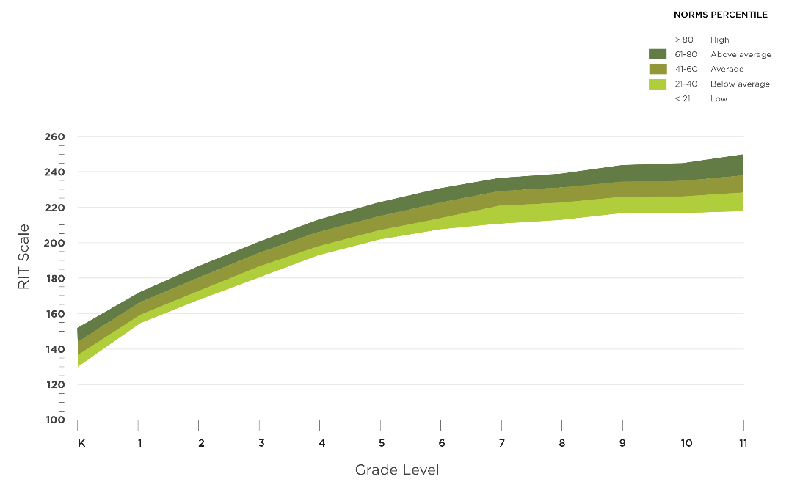
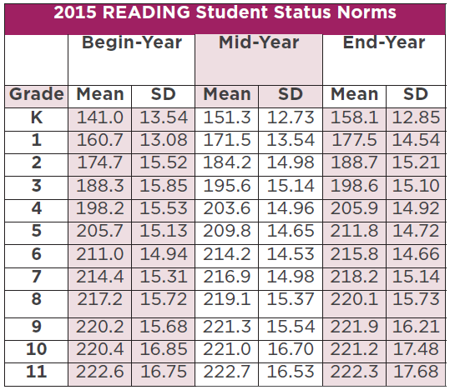
Normative Data: Bringing Context to the Data
Grade-level norms
Typical performance
Beginning, middle, and end of year
Forward
Notes:
Animated slide
Note: The Forward link takes you to the next slide

Slide 59
NWEA Research
typical
What are expected RIT scores and RIT growth?
Normative data, grades K–11
Scale alignment studies
Align RIT scale with state proficiency benchmarks
NWEA Blueprints
Back
Notes:
Animated slide
Note: The Back link takes you back to Activating Prior Knowledge

Slide 60
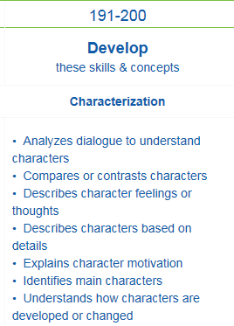
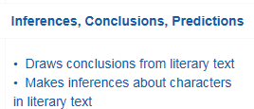
RIT Score
250
Ready for
Instruction
195
Today
120
Forward
Notes:
Animated slide
Note: The Forward link takes you to the next slide

Slide 61
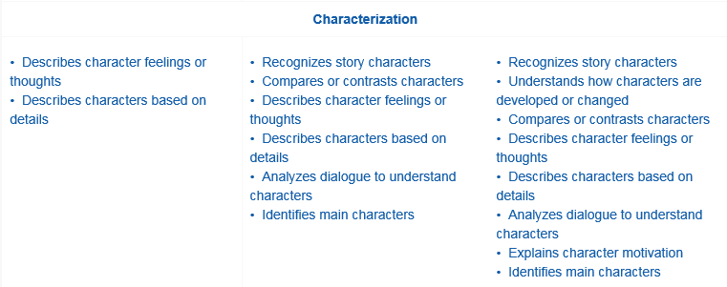
Rasch unIT (RIT) Scale
Grade-Level
Norms
RIT
Skills Data
Equal interval
Used to show growth over time
Independent of grade level
250
Learning Continuum
10
9
8
7
7
6
6
5
4
3
2
1
K
120
Back
Notes:
Hidden slide
Animated slide

Slide 62
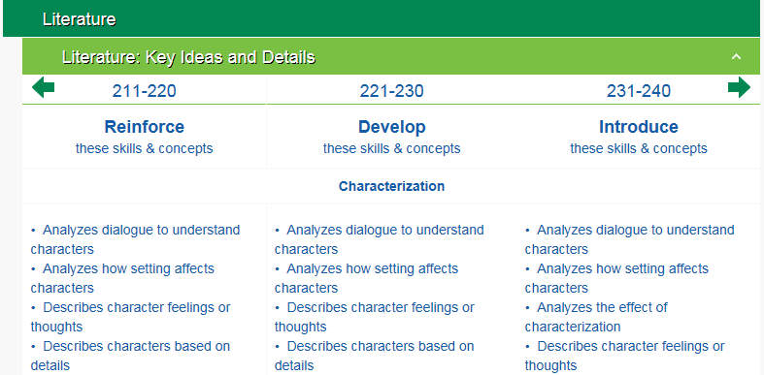
Measuring Growth
210
220
230
Grade-Level Norms
6th
7th
8th
11th
9th
The Learning Continuum
Back
Notes:
Animated slide
Note: The Back link takes you back to Activating Prior Knowledge

Slide 63
2015 Student Growth Norms

Slide 64
Instructional Level vs. Mastery
MAP Growth assessments:
Provide information about the instructional level of the student
Provide a road map for students toward achieving mastery
Are not tests for determining mastery of skills
Back
Notes:
Animated slide
Note: The Back link takes you back to Activating Prior Knowledge

Slide 65
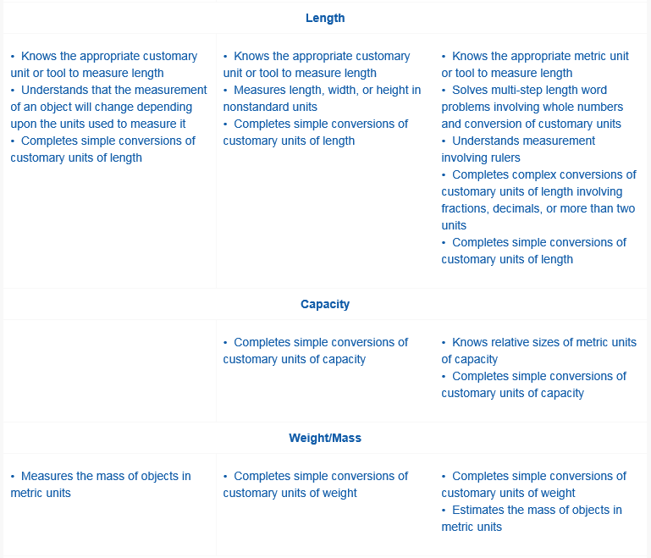
Learning Continuum Test View
Subject: Mathematics
Goal: Measurement and Data
Sub-goal:
Geometric Measurement and Problem Solving
Topics:
Length
Capacity
Weight/Mass
Forward
Notes:
Hidden slide
Animated slide

Slide 66
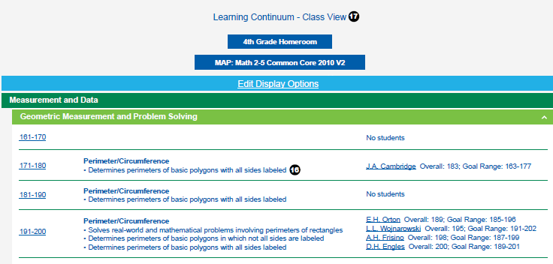
Learning Continuum Class View
Back
Notes:
Hidden slide
Animated slide

Slide 67
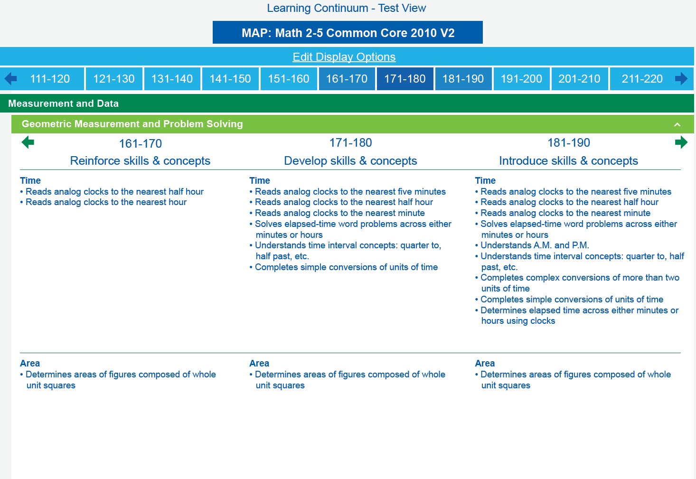
Growth: Math 2-5 CCSS 2010 V2
Images have been modified to demonstrate functionality. Actual in-product screens will be slightly different.
Back
Notes:
Note: The Back link takes you back to Activating Prior Knowledge

Slide 68
Using Data from MAP Growth Assessments
Finding gaps
Monitoring progress/growth
Monitoring programs
Conferencing
Informing instructional decisions
What else?

Slide 69
Explore MAP Growth Resources
NWEA.org
Research - State Linking Studies
MAP Growth Reports*
See examples of each report in Report Booklet
MAP Help Center *
NWEA® Professional Learning Online*
* Login required
| p. 32–38

Slide 70
Option 2 - Guided Tour Through Reports
Class Report
Class Breakdown by RIT/Goal/Profiency
Student Profile

Slide 71
4th Grade PeterOkeefe_PL1 InstructorPL1
5th Grade JenishaKotifani_PL1 InstructorPL1
5th Grade JaceFilek_PL1 InstructorPL1
6th Grade AshleyHoffmeyer_PL1 InstructorPL1
7th Grade BrandeeBarofsky_PL1 InstructorPL1
8th Grade FrankReband_PL1 InstructorPL1
9th Grade MariaSchoberg_PL1 InstructorPL1
Grade User Name Password

Slide 72
Explore the Class Report
What is the purpose of this report?
CIRCLE OR HIGHLIGHT
ADD QUESTION MARKS
DISCUSS WITH A PARTNER
Discuss your questions and confirm your understanding.
Which data points do you feel are important?
Which data points require more clarity for you?
Use the sample report in your Reports Portfolio, pp. 2–3
| Guide page
15

Slide 73
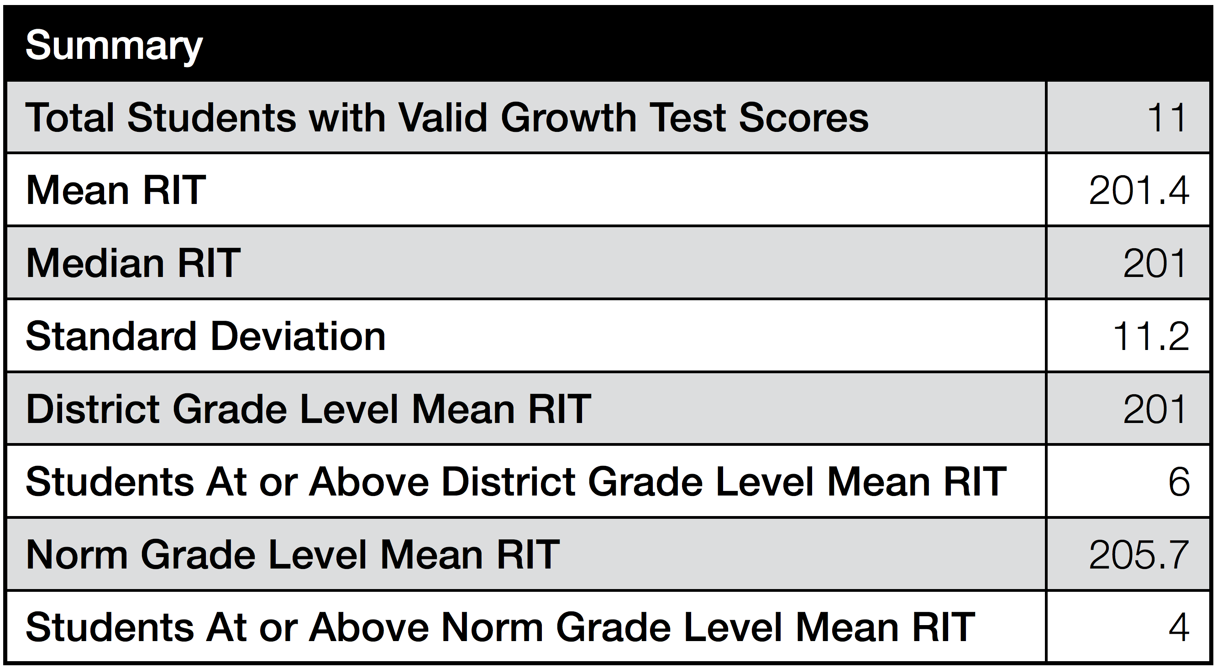
Notes:
Animated slide

Slide 74
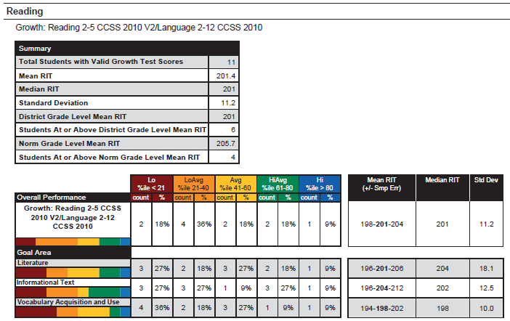
How do these Mean RIT scores compare?
How do the Goal Area Mean RITs compare to the Class Mean RIT?
What do you notice about Standard Deviations?
Norm Grade Level Mean RIT 205.7
Notes:
Animated slide.

Slide 75
Notes:
Animated slide

Slide 76
Key Ideas and Possible Uses
| Guide page
20

Slide 77
Notes:
Animated slide

Slide 78
Explore the Class Breakdown by RIT and by Goal Reports
What is the purpose of this report?
CIRCLE OR HIGHLIGHT
ADD QUESTION MARKS
DISCUSS WITH A PARTNER
Discuss your questions and confirm your understanding.
Which data points do you feel are important?
Which data points require more clarity for you?
Use the sample reports in your Reports Portfolio, pp. 4–5.
| Guide page
22

Slide 79
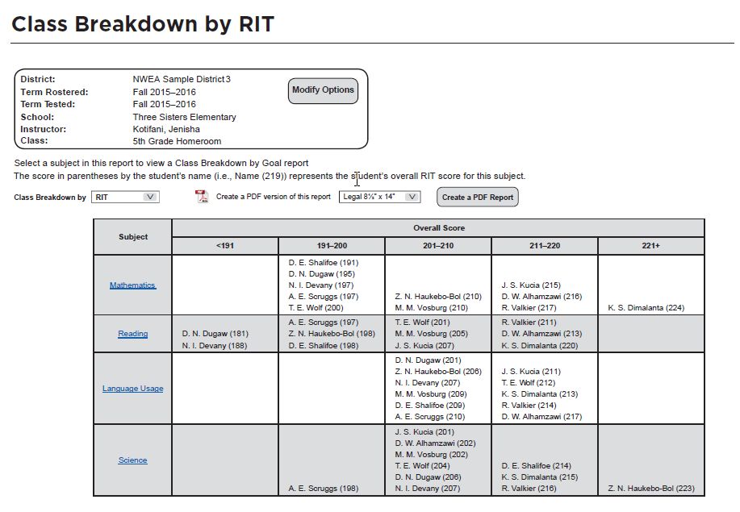
Notes:
Animated slide

Slide 80
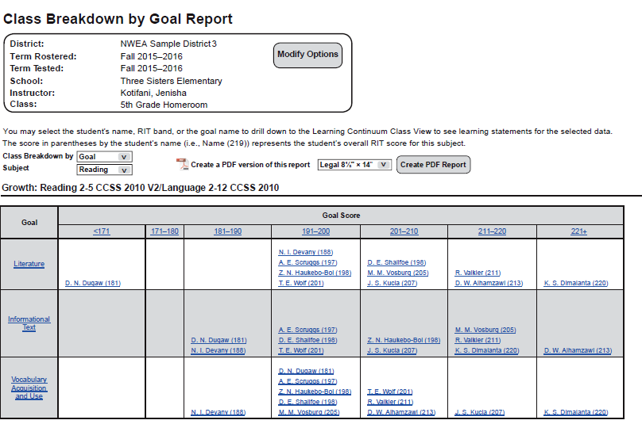
Notes:
Animated slide

Slide 81
Key Ideas and Possible Uses
| Guide page
23

Slide 82
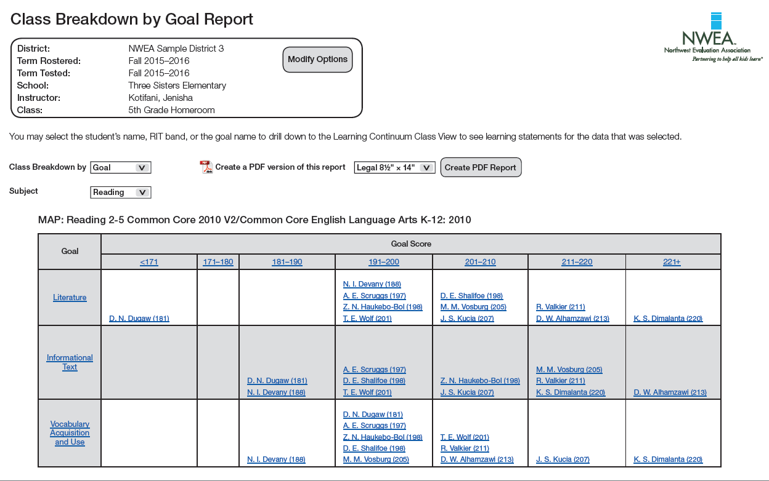
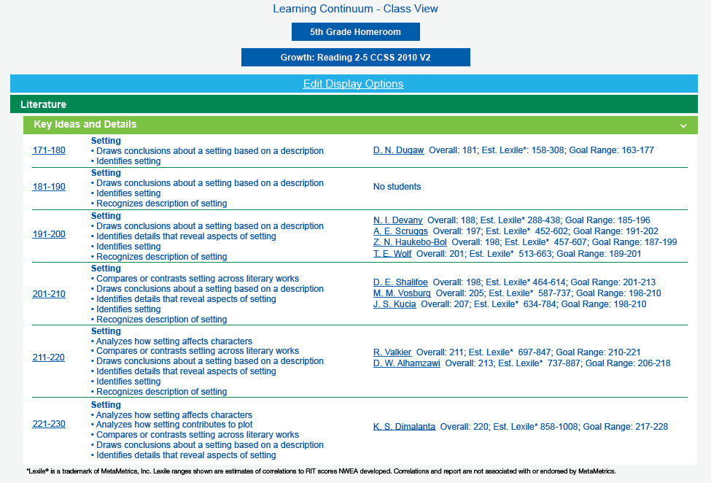
Student Data to Learning Statements
Notes:
Animated slide

Slide 83
Explore the Learning Continuum
What is the purpose of this report?
CIRCLE OR HIGHLIGHT
ADD QUESTION MARKS
DISCUSS WITH A PARTNER
What information requires more clarity for you?
Discuss your questions and confirm your understanding.
In what ways are the Class View and Test View similar? Different?
Use the sample reports in your Reports Portfolio, pp. 6–11.
| Guide page
24

Slide 84
Notes:
Animated slide

Slide 85
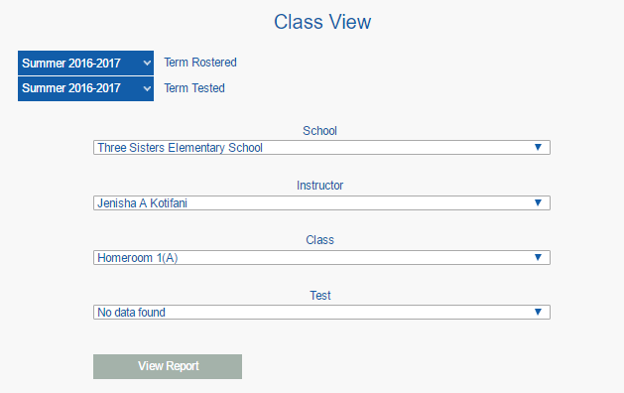

Slide 86
The Test View shows skills and concepts to reinforce, develop, and introduce with students based on their RIT score for each instructional/goal area.
Images have been modified to demonstrate functionality. Actual in-product screens will be slightly different.
Notes:
Animated Slide: Learning Continuum Test View

Slide 87
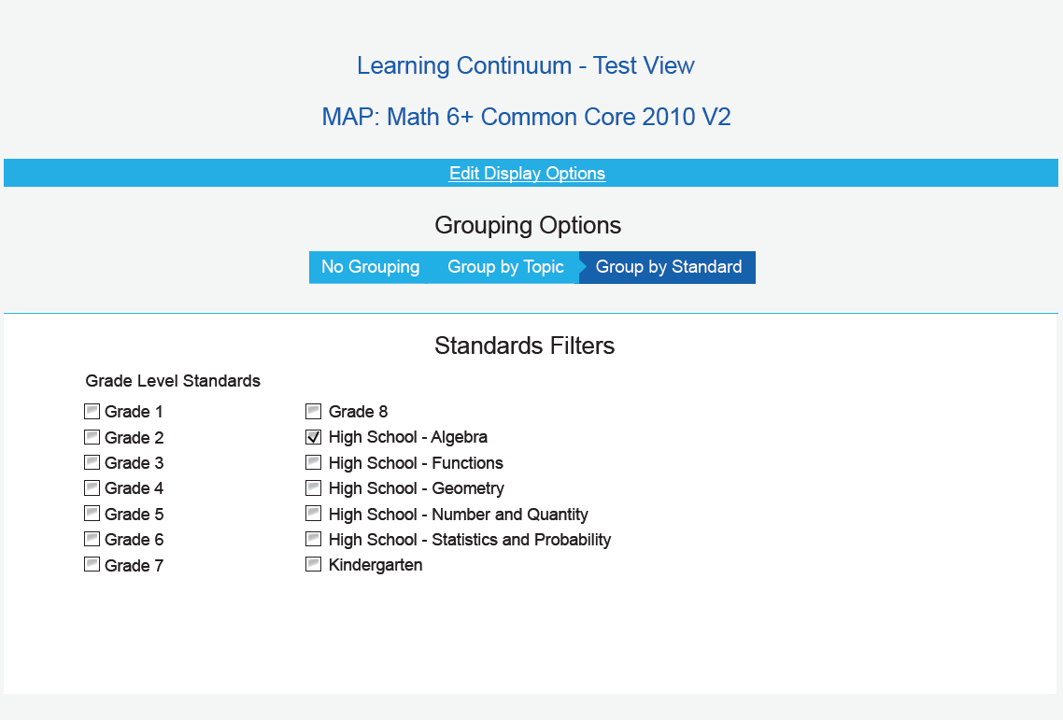
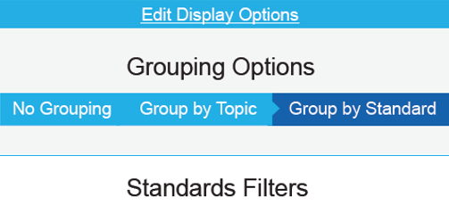
Select Edit Display Options in the Test or Class View to see the grouping and filtering options.
Learning statements can be grouped by topic or standard and filtered to show specific grade-level standards.
Notes:
Animated Slide: Learning Continuum Grouping Options

Slide 88
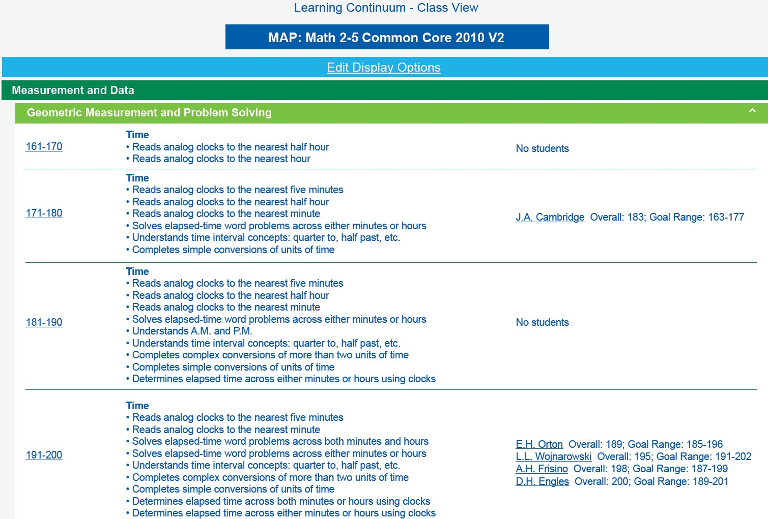
The Class View groups students based on skills and concepts they need to develop in each instructional/goal area and sub instructional/goal area.
Images have been modified to demonstrate functionality. Actual in-product screens will be slightly different.
Notes:
Animated Slide: Learning Continuum Class View

Slide 89
Key Ideas and Possible Uses
| Guide page
25

Slide 90
Explore the Student Profile Report
What is the purpose of this report?
CIRCLE OR HIGHLIGHT
ADD QUESTION MARKS
DISCUSS WITH A PARTNER
What do you notice? What does it tell you about a student?
What information requires more clarity for you?
Discuss your questions and confirm your understanding.
Use the sample reports in your Reports Portfolio, pp. 18–19.
Log into MAP to explore the interactive features of this report.
| Guide page
45

Slide 91
Notes:
Animated slide

Slide 92
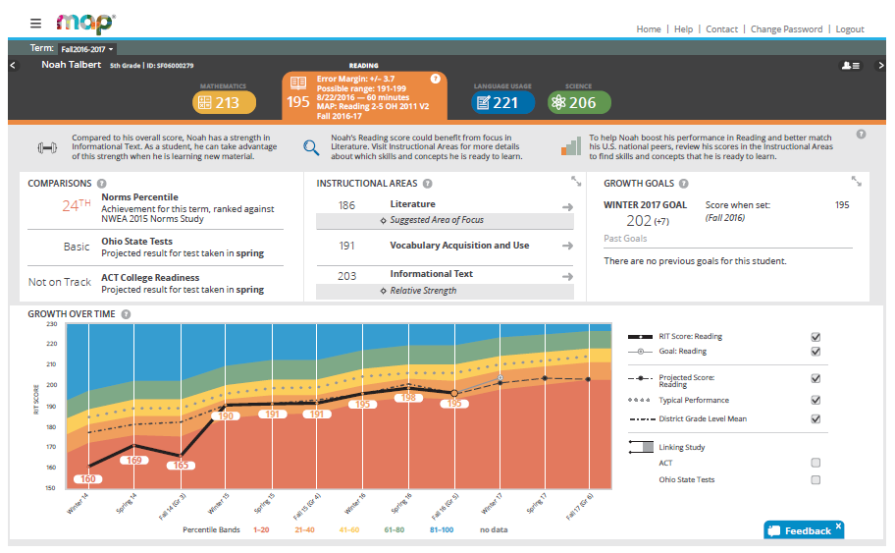

Slide 93
