Slide 1
Ecology
Study of how living things interact with their environment
Objective: Students will be able to explain how biotic and abiotic factors influence an ecosystem.

Slide 2
Ecology root = Eco = house
Ecology is the study of nature’s houses and the animals that live in them!
The thin surface layer of the earth that “houses” all living things is called the Biosphere.
Ecologists study interactions among organisms and between organisms and their environments

Slide 3
Factors that affect organisms:
Biotic Factors: any living thing in the environment that could affect an organism
Abiotic Factor: non-living parts of the environment that can affect an organism
Think ~ Pair ~ Share

Slide 4
biosphere
Pg. 64-65
biome
ecosystem
community
population
species

Slide 5
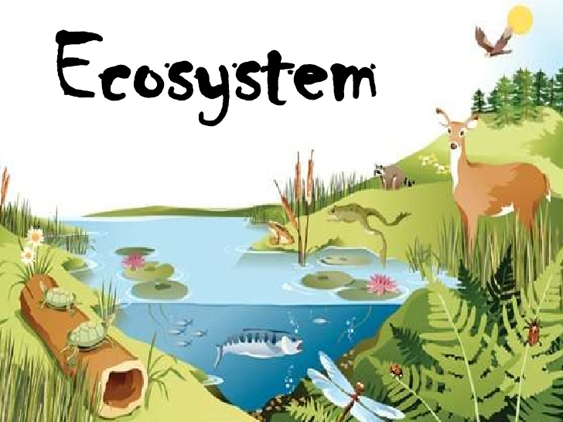
Abiotic Factors
*1
*2
*3
*4
*5

