Slide 1
The Nature of Science
Physics – Unit 1

Slide 2
What is Science?
Defined as: the intellectual and practical activity encompassing the systematic study of the structure and behavior of the physical and natural world through observation and experiment
Interesting Perspectives
“Our brains have evolved to help us survive within the orders of magnitude of size and speed at which our bodies operate.”
- Richard Dawkins
“Science is a way of knowing”
- Dr. John Armstrong WSU

Slide 3
What is it to “KNOW”
To know is to be aware of through observation, inquiry, or information.
“I have no special talents. I am only passionately curious.”
- ???????

Slide 4
Why curiosity is so important.
https://youtu.be/l9EuIEzxcHQ

Slide 5
The Process…
Visual and Auditory observations begin as soon as life begins.
As the brain matures, we make correlations and inferences through the learning process.

Slide 6
The Discovery Process

Slide 7
A More Specific Method
The Most Basic Science – Physics
Science: analogous to “NATURAL PHILOSOPHY”
The study of unanswered questions about nature.
Branches of Science
Living things – Biology, Botany, Zoology
Non-Living – Physics, Chemistry, Geology, Astronomy
ALL EXPRESSED USING THE LANGUAGE OF MATHEMATICS

Slide 8
The Scientific Method
1 – Recognize a problem
2 – Create a hypothesis
An educated guess based on observed bias and experience
3 – Predict consequences of the hypothesis
4 – Perform experiments to test predictions
5 – Conclusion: Formulate the simplest general rule that organizes the three main ingredients: Hypothesis, Prediction, and Experimental Outcome.

Slide 10
Important Terms and Distinctions
FACTS – close agreement by competent observers who make a series of observations of the same phenomenon.
LAWS/PRINCIPLES – When hypotheses are tested over and over, never being contradicted or falsified.
SCIENCE MUST BE ADAPTABLE AND ACCEPT THAT WORTHY EVIDENCE CAN CREATE DRASTIC CHANGE WITHIN THE IDEA OF A HYPOTHESIS, LAW OR PRINCIPLE.

Slide 11
Important Terms and Distinctions
A THEORY in a scientific context is very different than the theory which people use in everyday speech.
The layman would use the term theory in the same manner that a scientist would use the word hypothesis.
Recall the meaning of the term hypothesis
A scientific theory, on the other hand is a synthesis of a large body of information that encompasses well-tested and verified hypotheses about certain aspects of the natural world.

Slide 12
Important Terms and Distinctions
Hypothesis vs. Theory
Hypothesis – Untested
Theory – extensively tested and verified
Qualitative data vs. Quantitative data
Qualitative data – linguistic representation of observations (typically involving bias/high probability of misinterpretation)
Quantitative data – objective numeric representation of observation.
Scientific Statement vs. Speculation
Scientific statements – MUST BE TESTABLE
Speculation – no testability (is not science)

Slide 13
Science, Art, & Religion
All are manifestations of the search for order and meaning in the world.
Science – Concerned with discovering and recording natural phenomena.
Art – Concerned with the value of human interactions as they pertain to the senses.
Religion – Concerned with the source, purpose, and meaning of everything.
A truly educated person is knowledgeable about all three domains
With true understanding, all domains can be embraced without contradiction.

Slide 14
Tools of Understanding Science
Mathematics and the nuances thereof

Slide 15
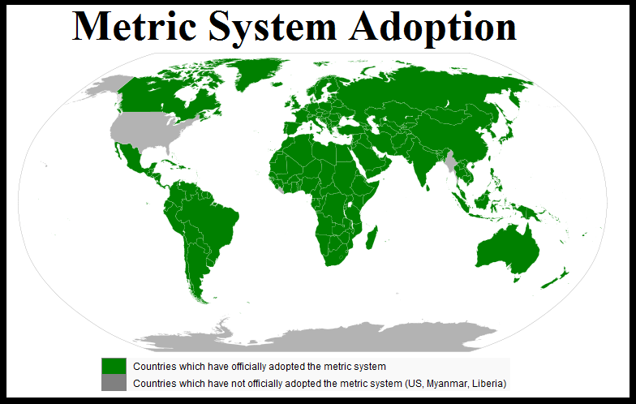
Measurement in Data collection
Familiar measurement tools???
Units???

Slide 16
The Metric System
Simple to use and convert between different magnitudes
Base 10 system (factors of 10)

Slide 17
Remember the Prefixes
Kids = Kilo-
Have = Hecto-
Dropped = Deca-
Over = BASE UNIT (gram, liter, meter)
Dead = Deci-
Converting = Centi-
Metrics = Miili-

Slide 18
Relationships
1 milliliter is the same as 1 cubic centimeter (volume)
1 mL = 1cm³
The mass of 1 milliliter of water is approximately 1 gram
1 L (H₂O) = 1 kg (H₂O)

Slide 19
LENGTH - The Standard Unit is the meter

Slide 20
VOLUME - The standard unit of volume is the liter

Slide 21
MASS - The standard unit is the gram

Slide 22
Temperature
Fahrenheit
F = 9/5C + 32
Celsius – SI standard for temperature
C = 5/9 (F – 32)
C = Kelvin + 273
Kelvin – Scientific scale representing Kinetic energy of molecules within a substance
Kelvin = C – 273
Has no negative values

Slide 23
Representing the Large or Small
Scientists use what is called SCIENTIFIC NOTATION to represent very large measurements, or very small measurements.
EXAMPLES
Mass of a single electron = 9.1 x 10⁻³¹ kg
Mass of the Earth = 5.92 x 10²⁴ kg

Slide 24
Significant Figures
A Significant Figure is each digit of a number that are used to express it to the required degree of accuracy, starting from the first nonzero digit.
RULES
Non-zero digits are always significant
Any zeros between two significant digits are significant(sandwiched)
A Final zero or trailing zeros in the decimal portion ONLY are significant.

Slide 25
Accuracy vs. Precision
Accuracy – how close a measured value is the ACTUAL (true) VALUE
Precision – how close the measured values are to each other.

