Slide 1
What is an Element?
How many elements can you list or name?

Slide 2
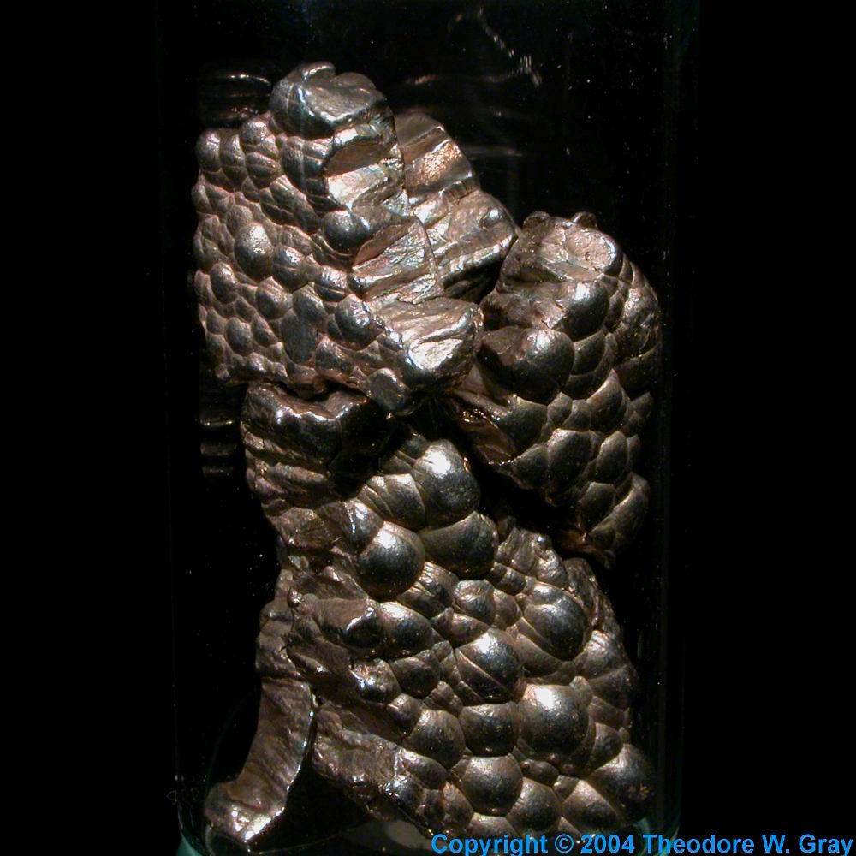
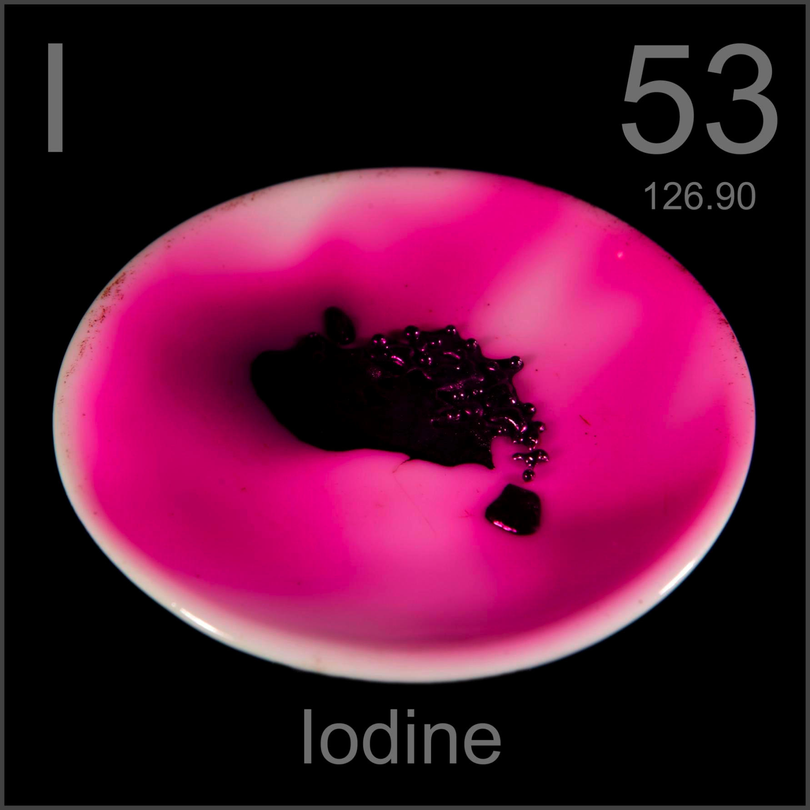
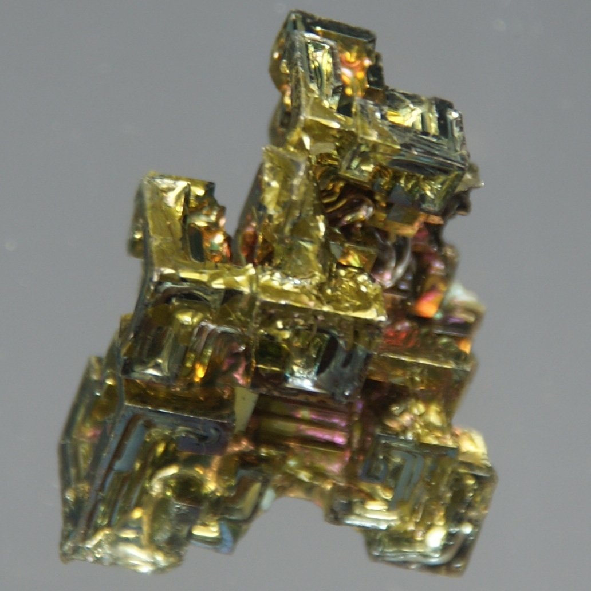
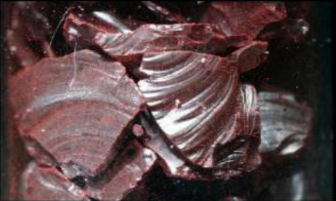
Elements
Cobalt
Co
Pd
A pure substance that is made up of only one type of atom.
Cannot be chemically or physically split into something simpler
Palladium
Bismuth
Bi
P
Each element has unique properties
Characteristics
“Personality”
Behavior
Phosphorus

Slide 3
Click me for more…

Slide 4
More
Make three inferences about the elements based on this graphic.

Slide 5
Exit Slip
Answer the following on a slip of scrap paper and turn it in as you leave.
What is an element? (Be as thorough and specific as you can)
Give three examples.

Slide 6
Elements are represented by a symbol and a number
Atomic Number
# of Protons
Atomic Number: DNA for elements, there is only one element with each number.
Can be used to identify element
Symbols for elements have many different origins
alchemy
Latin
English
Towns
People
Movements
Potassium – K
“Kalium”, latin
Iron – Fe
“Ferrum” latin
Atomic Mass
# protons + # neutrons = mass of nucleus

Slide 7
Correct Capitalization is Not Optional
First letter of each symbol is capitalized and second is not!!!
Fe – iron
Ca – calcium
Br – bromine
If you do it means something completely different
NI – Nitrogen Iodide
Ni – Nickel
CO – Carbon monoxide
Co - cobalt

Slide 8
Use your periodic table & notes to answer the following
The periodic table is placed in order according to element _______________.
What is the atomic number of oxygen?
What is the symbol for Krypton?
What is the atomic mass of Sodium?

