Slide 1
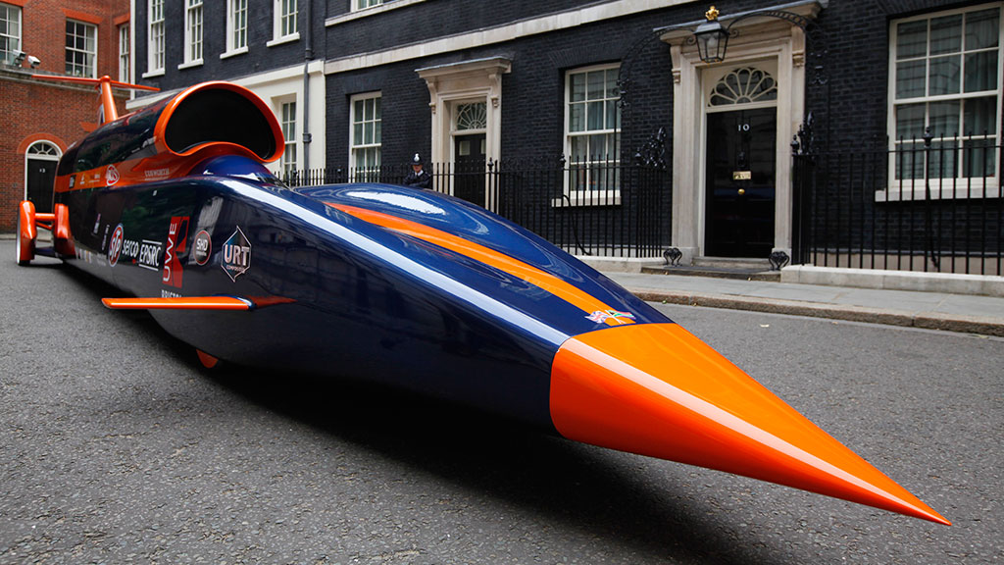
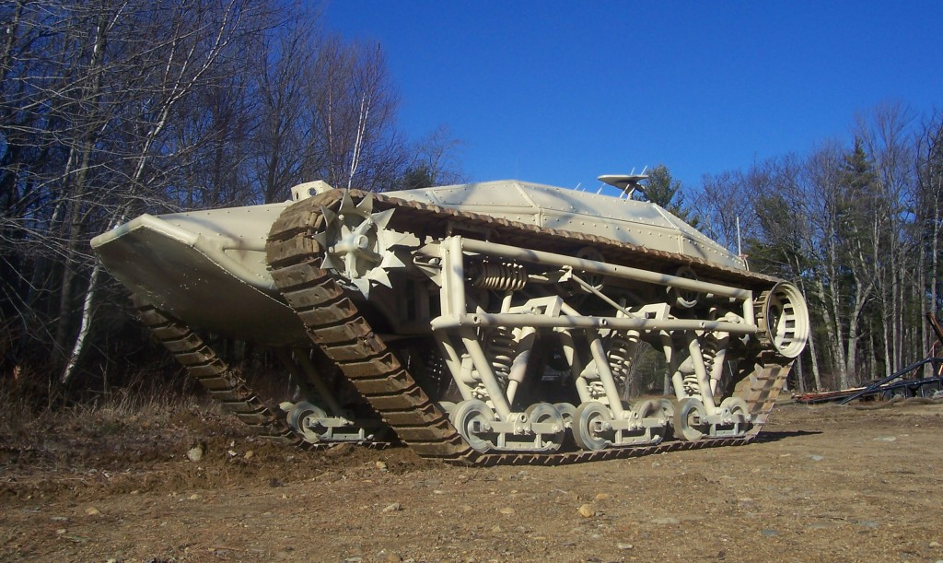
How would you describe or compare these two vehicles?

Slide 2
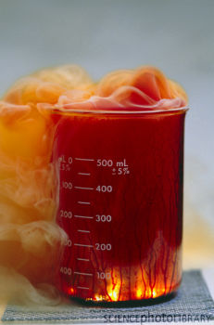
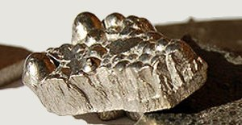
How do we compare and describe matter?
Properties:
a quality, trait or characteristic of something

Slide 3
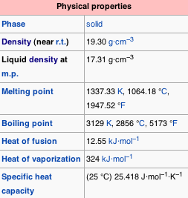
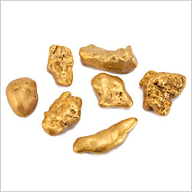
Physical Properties
Can be observed or measured without changing the substance chemically.
State of matter at room Temperature
Appearance (Color, Luster, Texture)
Smell
Boiling point, freezing point, etc…
Density: mass per unit volume
Conductivity: carry electricity or heat
Malleable: can be hammered or pressed permanently.
Ductile: can be stretched into wire

Slide 4
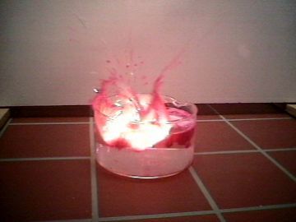
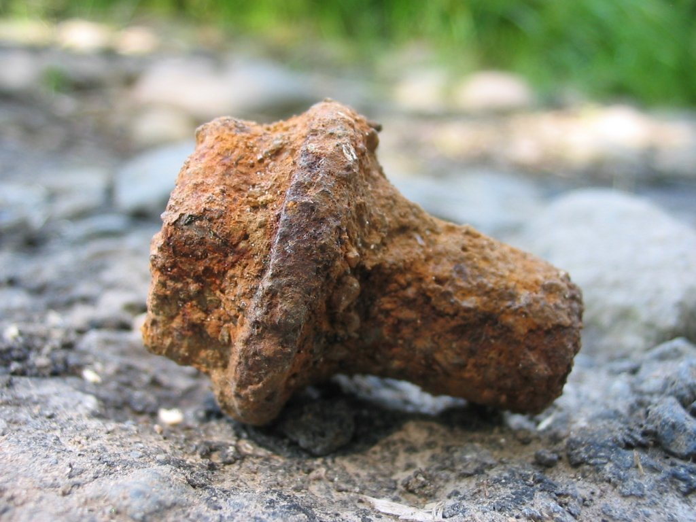
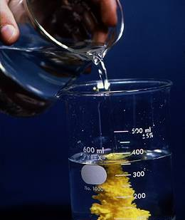
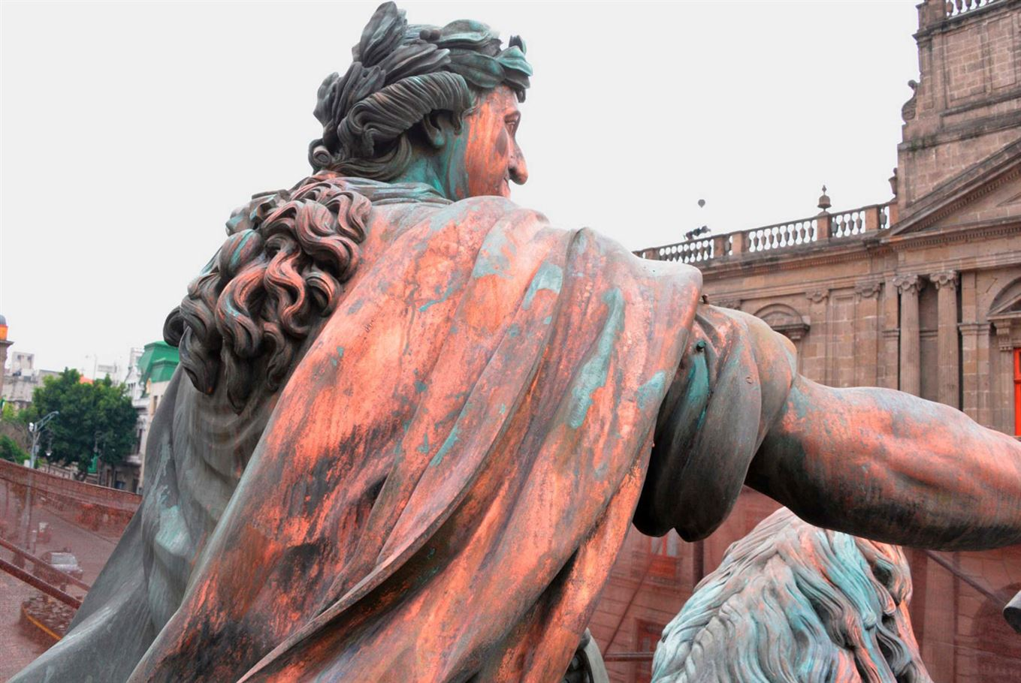
Chemical Properties
Describe how substances react or change when they come in contact with other substances.
Reactions to acid, water, air,
Ability to rust, tarnish
Does it burn? Flammable
What does it react with?
What does it Bond up with?

Slide 5
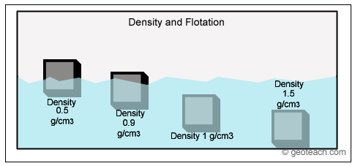
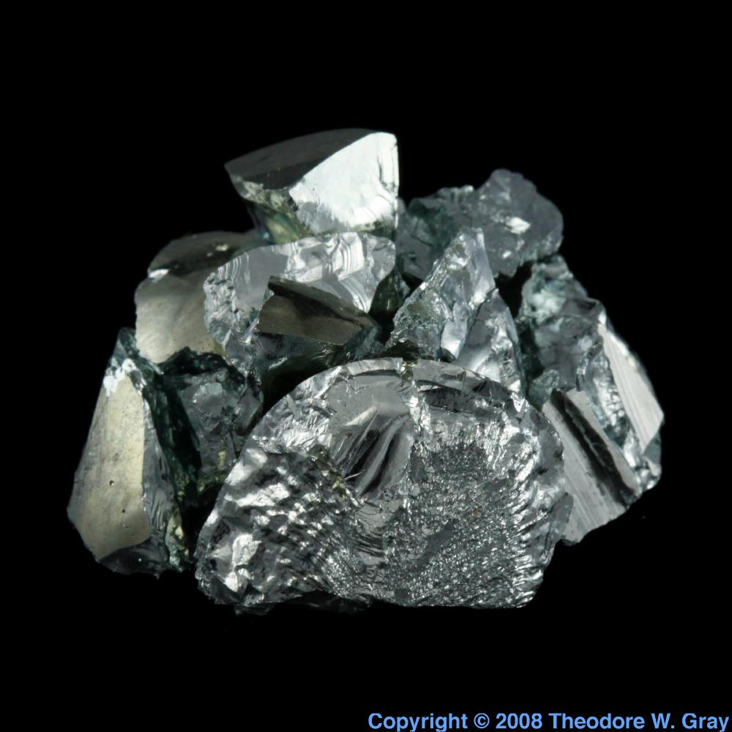
Density- Amount of matter in a given space; mass per unit volume
Density = mass ÷ volume
Unique for each element, can be used to identify them
Units: g/mL, g/cm³
11.4 g/ml

Slide 6
Properties of elements lab

